Slide 1
THINGS TO ADD / INCORPORATE
CHANGE LOG
VA and VA.gov tool stack onboarding, offboarding, and access
Deliverable / governance ownership to roles and responsibilities

Slide 2
VA CEDAR IDIQ TO1 VFS-DHM Reporting

Slide 3
Mission
VA CEDAR IDIQ
The CEDAR IDIQ will connect VA employees with industry partners to deliver high-quality, digital products following modern best practices to improve service delivery to Veterans.

Slide 4
Objectives
VA CEDAR IDIQ
Give VA streamlined access to a small group of exceptional companies that specialize in agile software development and user-centered design
Create a contract mechanism that incentives VA employees and contractors to deliver rapidly following private sector best practices
Promote the principles of Agile and DevOps culture in VA
Support VA’s Digital Modernization Strategy to solve tough technology challenges facing VA

Slide 5
VA CEDAR IDIQ TO1
VETERAN-FACING SERVICES – DIGITAL HEALTH MODERNIZATION
Compliance, Governance and Reporting
CLIN 0001AA: Delivery Report
CLIN 0001AB: Monitoring Report
CLIN 0001AC: Contractor’s Progress, Status and Management Report
CLIN 0001AD: Status of Government Furnished Equipment Report
CLIN 0001AE: Personnel Contractor Manpower Report
CLIN 0001AF: Contractor Staff Roster
Last updated: 10/13/2021

Slide 6
VA CEDAR IDIQ TO1
VETERAN-FACING SERVICES – DIGITAL HEALTH MODERNIZATION
Compliance, Governance and Reporting
CLIN 0001AA: Delivery Report
CLIN 0001AB: Monitoring Report
CLIN 0001AC: Contractor’s Progress, Status and Management Report
CLIN 0001AD: Status of Government Furnished Equipment Report
CLIN 0001AE: Personnel Contractor Manpower Report
CLIN 0001AF: Contractor Staff Roster

Slide 7
Delivery Report
CLIN 0001AA
The Contractor shall provide a monthly report, detailing and providing links to all stories, epics, and other work completed. This includes all work accepted by the Product Owner and Contracting Officer Representative at the end of each sprint. This report shall include additional details about the project status, sprint team velocity, sprint team goal completion, and highlight project risks. The specific data points and format of this monthly report shall be determined by the Contractor in collaboration with the Government Product Owner and COR.
Links to all stories, epics, and other work completed
Additional details about the project status, sprint team velocity, sprint team goal completion, and highlight project risks

Slide 8
Reporting Requirements
CLIN 0001AA
CLIN 0001AA: Delivery Report
CLIN 0001AB: Monitoring Report
CLIN 0001AC: Contractor’s Progress, Status and Management Report
CLIN 0001AD: Status of Government Furnished Equipment Report
CLIN 0001AE: Personnel Contractor Manpower Report
CLIN 0001AF: Contractor Staff Roster

Slide 9
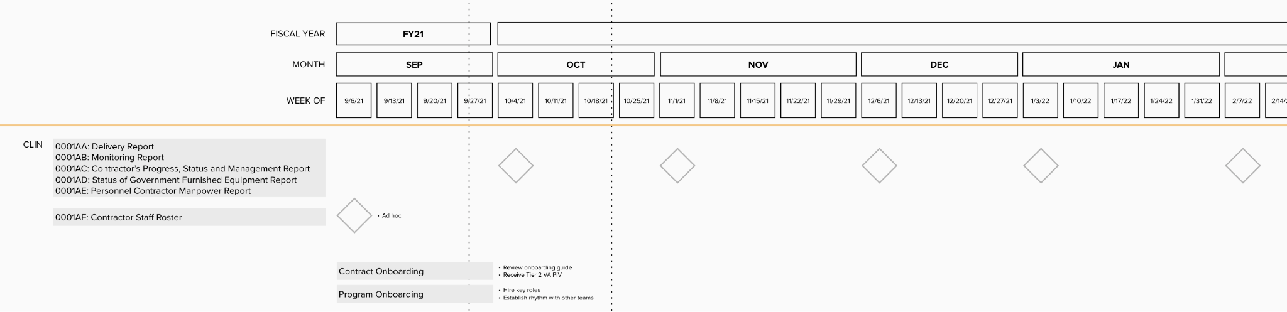
Reporting Roadmap
CLIN 0001AA
Contract Reporting Roadmap

Slide 10
VA CEDAR IDIQ TO1
VETERAN-FACING SERVICES – DIGITAL HEALTH MODERNIZATION
Compliance, Governance and Reporting
CLIN 0001AA: Delivery Report
CLIN 0001AB: Monitoring Report
CLIN 0001AC: Contractor’s Progress, Status and Management Report
CLIN 0001AD: Status of Government Furnished Equipment Report
CLIN 0001AE: Personnel Contractor Manpower Report
CLIN 0001AF: Contractor Staff Roster

Slide 11
Monitoring Report
CLIN 0001AB
The Contractor shall provide a monthly report, highlighting and providing links to key infrastructure and application monitoring data. The report shall include details with links to documentation for any critical incidents or outage events that resulted in service outages or significant service degradations. The Contractor shall attach or provide links to postmortem documentation for all critical incidents or outage events. The specific data points and format of this monthly report shall be determined by the Contractor in collaboration with the Government Product Owner and COR.
Links to all stories, epics, and other work completed
Additional details about the project status, sprint team velocity, sprint team goal completion, and highlight project risks

Slide 12
Show me, don’t tell me

Slide 13
Sprint Operating Model
CLIN 0001AB
Sprint Approval
Sprint Execution
Sprint Wrap Up
Ceremony | Conduct Backlog Prioritization, Sprint Planning and Document Sprint Approval Form | Submit Sprint Approval Form for Approval via email | Conduct Daily Standups and Deliver on Spring Goals, EPICs, Stories, and Tasks | Conduct Sprint Demo and Retrospective | Submit Sprint Deliverables and Acceptance Form for Acceptance via email | Send Written Acceptance of Sprint via email | Submit Invoice via Tungsten
Approver / Accepter |  | VA Product Owner (Lauren A.) | VA Product Owner (Lauren A.) |  | VA Product Owner (Lauren A.) then COR (Mary O.) | VA COR (Mary O.) | --
Lead | MO | MO | MO | MO | MO | DHM | MO
Contributor | DHM / MO | -- | DHM | DHM | -- | -- | --

Slide 14
Sprint Tracker
CLIN 0001AB
Task Order | 36C10B21N0070001 / 0001
CLIN | 0001
Sprint # | 0 | 1 | 2 | 3 | 4 | 5 | 6 | 7
Sprint Approver Name | Lauren Alexanderson | Lauren Alexanderson or Meg Peters | Meg Peters | Meg Peters
PoP | Base Year | Base Year | Base Year | Base Year
Running Total | 1 of 26 | 2 of 26 | 3 of 26 | 4 of 26
Approval Date | 9/7/2021 | 9/21/2021 | 10/1/2021 | 10/19/2021
Start Date | 9/8/2021 | 9/22/2021 | 10/6/2021 | 10/20/2021
End / Demo Date | 9/21/2021 | 10/5/2021 | 10/19/2021 | 11/2/2021
PO Acceptance Date | 9/21/2021 | 10/5/2021 | 10/19/2021 | TBD
COR Acceptance Date | 9/22/2021 | 10/7/2021 | 10/26/21 | TBD
Invoice Submitted Date | 9/24/2021 | 10/11/21 | 10/19/21 | TBD
Invoice Paid Date | 10/12/21 | 10/26/21 | Pending | TBD

Slide 15
Show me, don’t tell me: Sprint 0 Demo
21 September, 2021

Slide 16
Sprint 0 Approval / Acceptance
CLIN 0001AB
Use strikethrough + explanation in text as shown.
Sprint Goals
Kickoff the program
Establish leadership and reporting norms
Build the team aligned on the right place to start
Focused Epics
Conduct Team Introductory Meeting
Plan and host formal Kickoff Meeting and ceremony cadence
Attend Project Onboarding session and begin digesting the DHM Onboarding Guide
Begin and monitor onboarding
Conduct stakeholder mapping to understand stakeholder landscape
Begin recruiting and hiring process for open roles and create team staffing structure
Develop backlog and plan for Sprint 1
Deliverables
Name / Description | Acceptance Criteria
Introductory Meeting | Attended Introductory Meeting and gathered additional information to coordinate and prepare for kickoff
Project Kickoff | Hosted formal kickoff meeting Aligned on approach, work plan, and onboarding strategy Scheduled agile ceremonies and gather additional details to fold into the program and product roadmap and backlog
Stakeholder Map | Reviewed DHM Landscape Map and synthesized new stakeholder learnings
Team Staffing Plan | Created and shared team staffing plan Incorporated product team feedback into recruiting
Backlog | Prioritized epics and backlog for Sprint 1

Slide 17
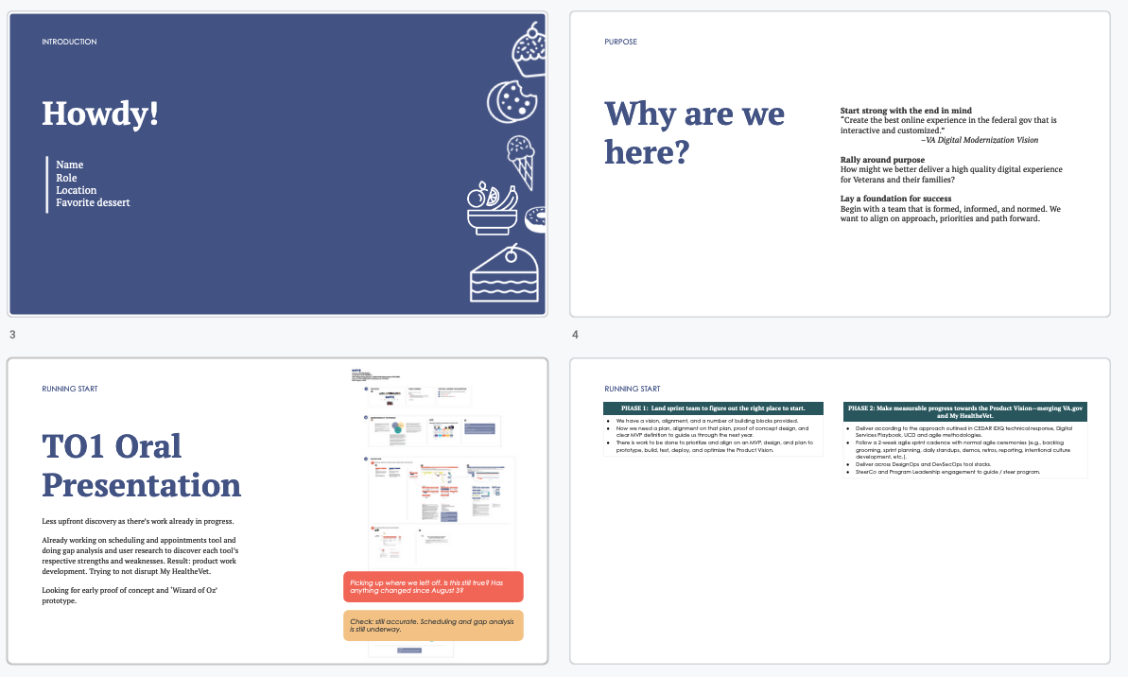
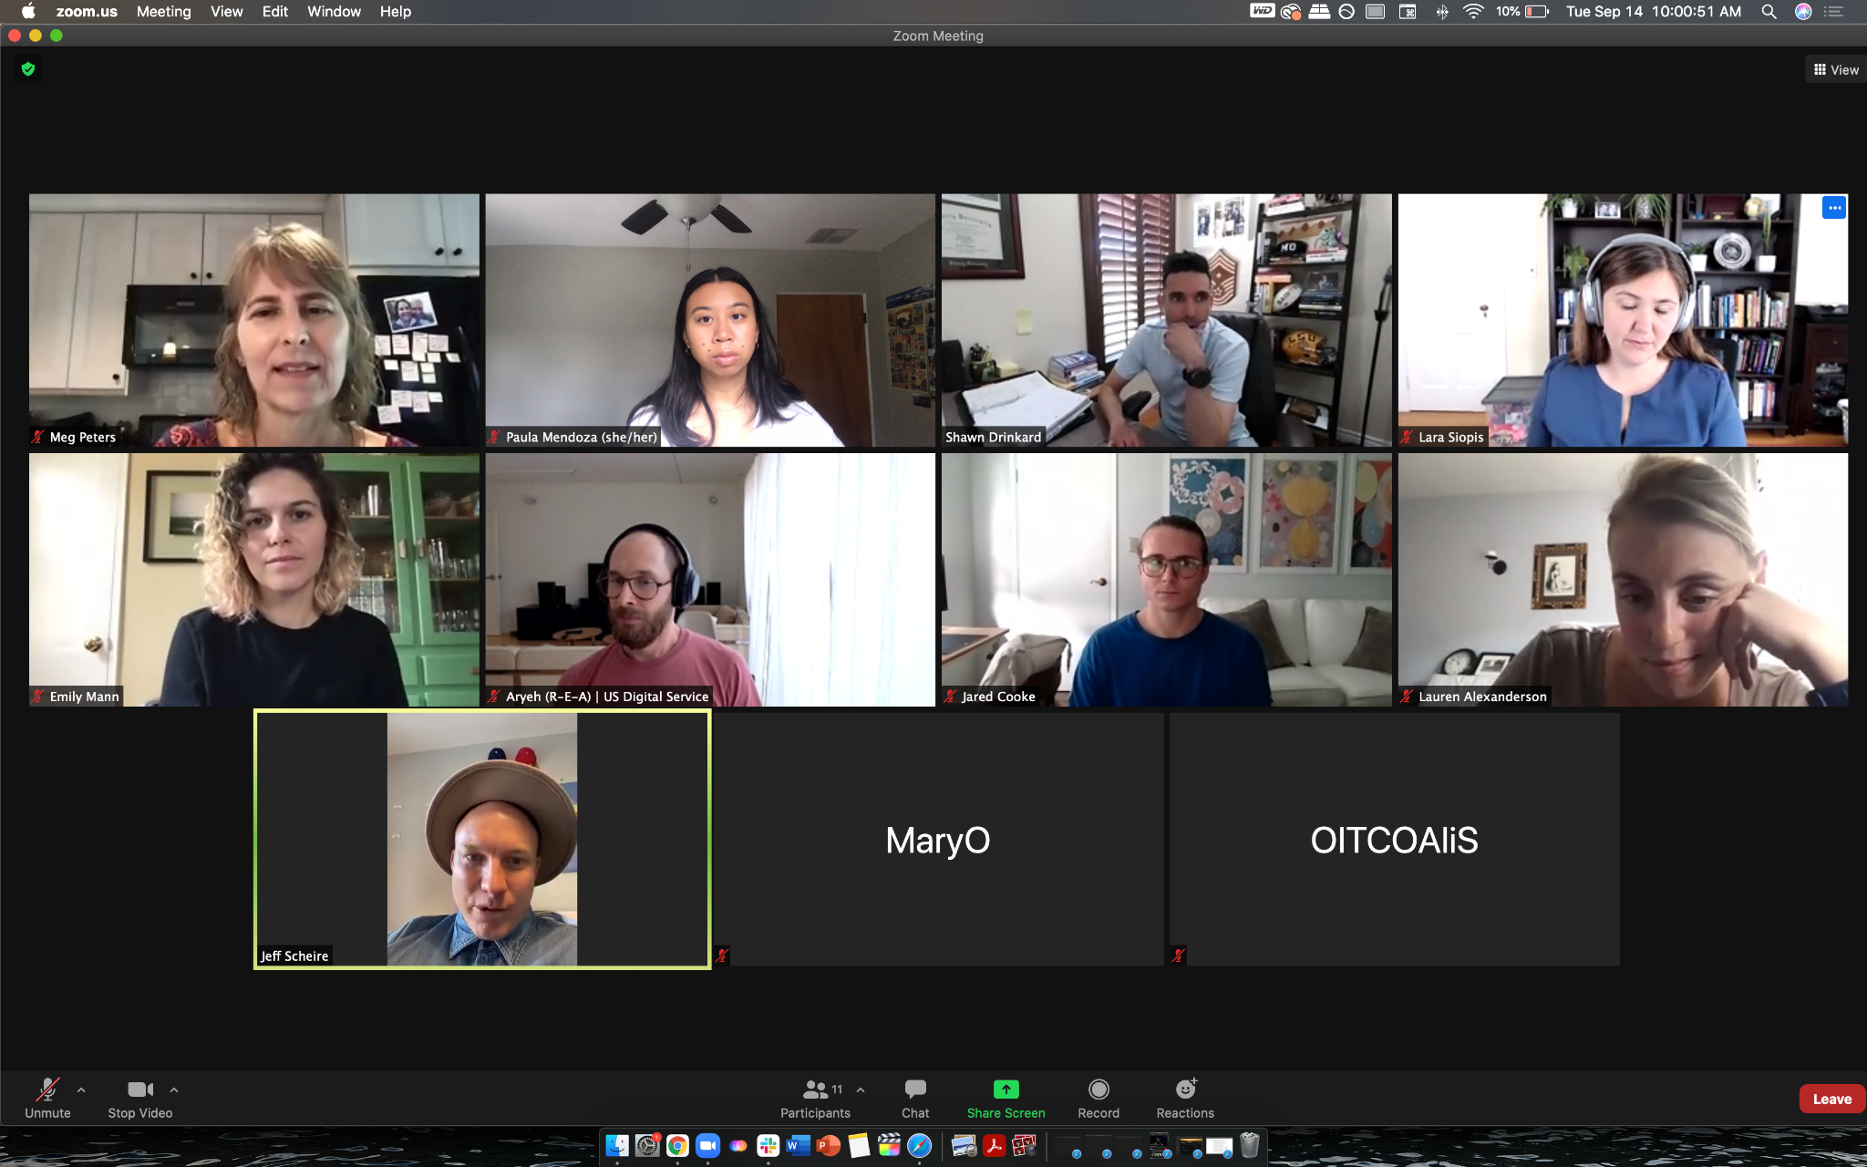
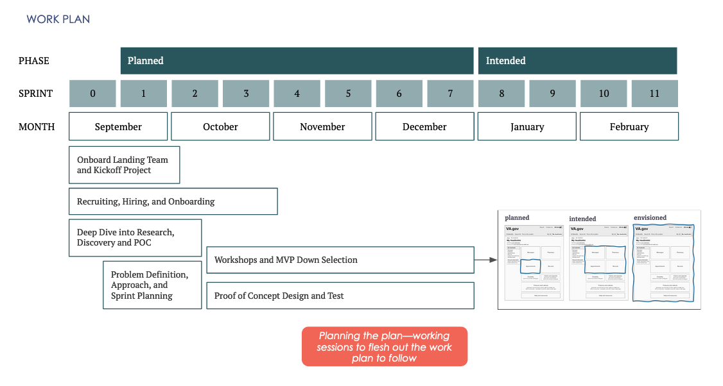
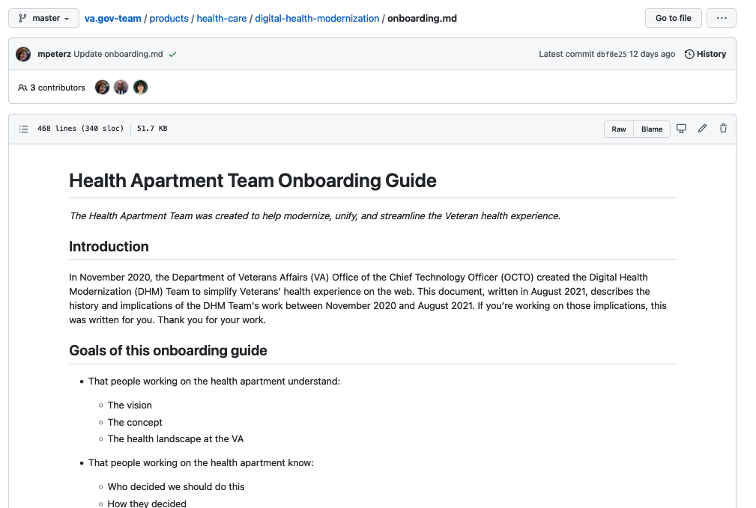
End of Sprint 0 Update
CLIN 0001AB
Sprint 0 started with a Green Light—we stepped on the pedal and set a foundation for defining the Sprint 0 Plan during the Kickoff.
We met the team during the Green Light Meeting and Project Onboarding and dove into the research to develop an understanding of the program At Kickoff, we aligned on 4 main themes for Sprint 0 and the need to understand key stakeholders, align as a team, onboard to the project and contract, and create a plan. We created Epics and tasks to guide the work.

Slide 18
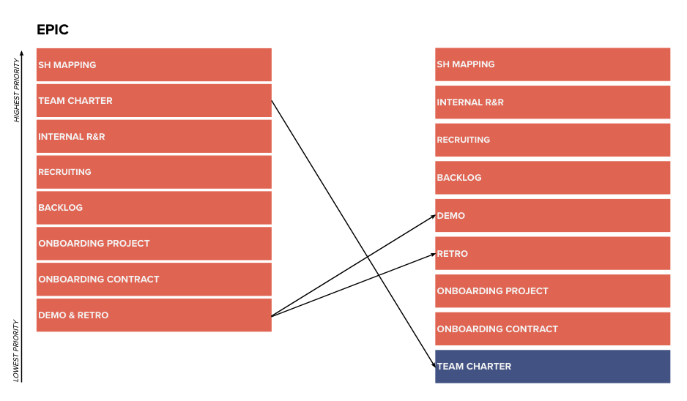
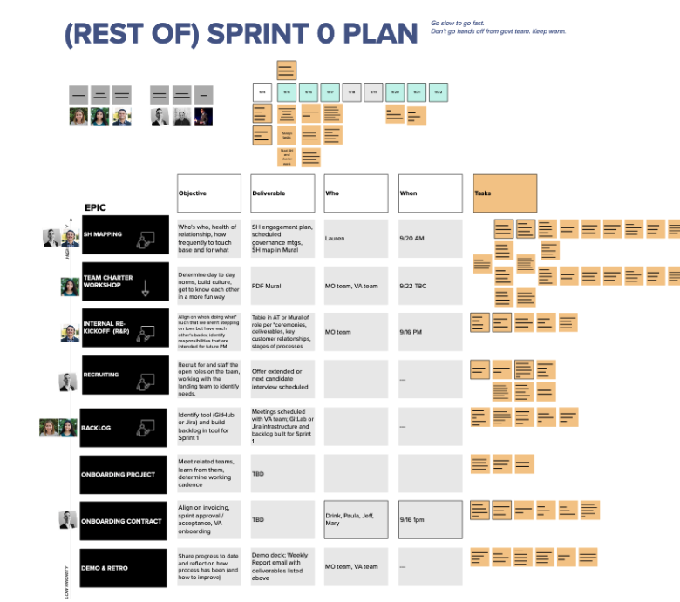
End of Sprint 0 Update
CLIN 0001AB
We remained agile and reprioritized as we learned.
To maximize participation at Team Charter, we gained approval to push it to Sprint 1 (9/27). We prioritized recruiting and backlog refinement as we recognized them to be key elements of successful alignment for the work ahead. As we were being onboarded, we identified the “Planned” Roadmap as a bigger activity and deemed it more realistic to be defined by end of Sprint 1 as further discovery discussions were needed upfront.

Slide 19
End of Sprint 0 Update
CLIN 0001AB
The team’s accomplishments this sprint include:
Onboard Landing Team and Kickoff Project
Prepared for and attended CEDAR IDIQ Task Order #1 - Green Light
Prepared questions for and attended Governance and Onboarding Orientation and met with Mary to align on governance and compliance
Conducted VA onboarding training with Kemi
Prepared for and conducted Kickoff Meeting
Conducted a MO Studio roadmap working session
Conducted MO Studio mid-sprint retrospective
Problem Definition, Approach, & Sprint Planning
Coordinated and scheduled agile ceremonies (stand up, demo, retro, sprint planning, backlog grooming)
Planned sprint tasks in an internal session to accomplish Work Plan
Prepared for and conducted an internal roles and responsibilities workshop
Prepared backlog materials for and collaborated with Aryeh to refine priorities for Sprint 0; conducted an initial grooming of the Sprint 1 backlog
Deep Dive into Research, Discovery, and Proof of Concept (POC)
Reviewed the Health Apartment Team Onboarding Guide and associated materials and completed Health Apartment Team Onboarding session
Conducted MO Studio stakeholder mapping working sessions and met with leadership team to synthesize existing stakeholder knowledge
Conducted Stakeholder Discussion with Lauren
Recruiting, Hiring, and Onboarding
Recruited for Product Lead, Developer, and UX Lead
Assessed sources to onboard Software Engineering Lead
Added six candidates in our interview pipeline
Interviewed candidate (2 separate panels) for Product Lead
Collaborated with Pluribus to assess teaming strategy for FE Developer
Interviewed three candidates for UX Lead
Began to develop subcontracts with McKinsey and Pluribus subcontractors

Slide 20
Sprint 0 Links to Work
CLIN 0001AB
Stakeholder Ecosystem Map
Link here.
Initial R&R Recruiting
Link here.
Backlog Development
Link here.

Slide 21
Sprint 0 Approval / Acceptance
CLIN 0001AB
Use strikethrough + explanation in text as shown.
Sprint Goals
Kickoff the program
Establish leadership and reporting norms
Build the team aligned on the right place to start
Focused Epics
Conduct Team Introductory Meeting
Plan and host formal Kickoff Meeting and ceremony cadence
Attend Project Onboarding session and begin digesting the DHM Onboarding Guide
Begin and monitor onboarding
Conduct stakeholder mapping to understand stakeholder landscape
Begin recruiting and hiring process for open roles and create team staffing structure
Develop backlog and plan for Sprint 1
Deliverables
Name / Description | Acceptance Criteria
Introductory Meeting | Attended Introductory Meeting and gathered additional information to coordinate and prepare for kickoff
Project Kickoff | Hosted formal kickoff meeting Aligned on approach, work plan, and onboarding strategy Scheduled agile ceremonies and gather additional details to fold into the program and product roadmap and backlog
Stakeholder Map | Reviewed DHM Landscape Map and synthesized new stakeholder learnings
Team Staffing Plan | Created and shared team staffing plan Incorporated product team feedback into recruiting
Backlog | Prioritized epics and backlog for Sprint 1

Slide 22
Show me, don’t tell me: Sprint 1 Demo
5 October 2021

Slide 23
Sprint 1 Approval / Acceptance
CLIN 0001AB
Use strikethrough + explanation in text as shown.
Sprint Goals
High: Prioritize getting the things we need from Emily (10/1) and Aryeh (10/4) before they roll off
High: Ensure we have what is needed to do the work (tools, intros)
High: Conduct Charter
Medium: Start problem definition; understand how this product fits into sitewide experience and understand challenges / working across different teams (focus on authentication, bridge, etc. and developing strategy)
Medium: Make progress in recruiting and further clarify roles
Low: Start technical discovery
Focused Epics
Crew introductions, stakeholder engagement, onboard project
Working tools
Team Charter
Agile ceremonies
Problem definition and approach
Recruiting
Deliverables
Name / Description | Acceptance Criteria
Knowledge Transfer (Aryeh and Emily) | Sessions conducted with Emily about discovery research, research ops, and IA Stakeholder working group / SteerCo scheduled with rough agenda
Toolstack Matrix | Tools, purpose, and access status identified and documented Deprioritized because...
Team Charter | Charter PDF created and agreed to by team
Sprint 2 Planning | Sprint 2 goals defined, epics prioritized prior to 10/5
Begin Problem Definition | Meetings with Meg conducted and questions / challenges synthesized
Recruiting Update | Up to date visual of the team and updates included in reporting
Contract Onboarding / Governance | Contract reports provided on time

Slide 24
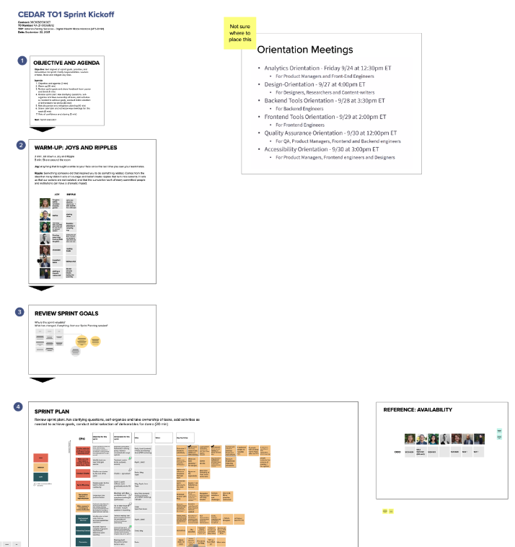
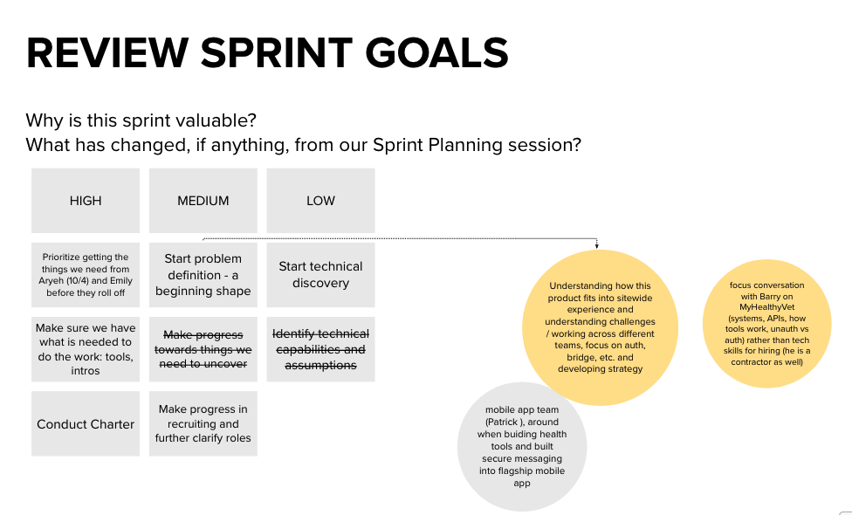
End of Sprint 1 Update
CLIN 0001AB
Sprint 1 epics and activities were built collaboratively and based on our accomplishments and learnings from Sprint 0.
We concluded Sprint 0 with a demo and retro highlighting our work to understand key stakeholders, align as a team, onboard to the project and contract, and create a plan. We also identified action items that we put into practice immediately as we headed into sprint planning and backlog grooming, collaboratively aligning on priorities, deliverables, and key activities. With Aryeh and Emily rolling off the team, we prioritized knowledge transfer and anchoring our learning around designing and building the POC.

Slide 25
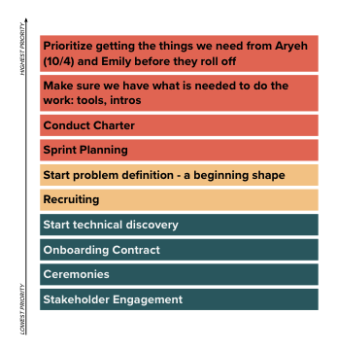
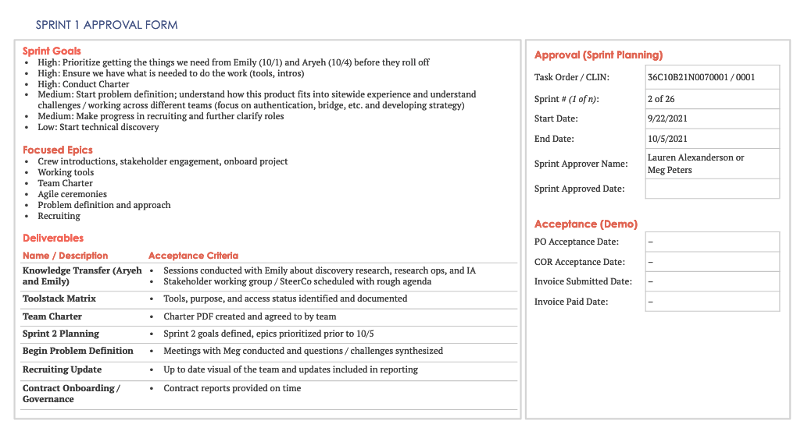
End of Sprint 1 Update
CLIN 0001AB
We remained agile and reprioritized as we learned.
Mid-way through the sprint, we began planning Sprint 2 and discussed the need to reprioritize activities based on a potential government shutdown. Taking a proactive approach, we brought forward discussions on Tree Test research planning for the POC IA which provided the opportunity to deep dive into the test plan with Emily. Although we didn’t pull the full research plan activity forward, we leveraged this exploration to take action and refine the design of the test. We are currently on track to deliver the planned scope for Sprint 1.

Slide 26
End of Sprint 1 Update
CLIN 0001AB
The team’s accomplishments this sprint include:
Deep Dive into Research, Discovery, and Proof of Concept
Conducted initial technical discovery and knowledge transfer session with Aryeh.
Scheduled technical discovery and introduction sessions with Barry Egbert (re: basics of MHV’s architecture), Mike Chelen (re: VA.gov architecture and any other relevant systems), and Cory Trimm (re: VA.gov tech stack, engineering practices, and login / identity).
Created a POC Discovery Tool in Mural to capture assumptions, risks, questions, and priorities on the wireframes and downloaded notes.
Created a Technical Discovery Tool in Mural to use as a framework for capturing notes and to drive the conversation for the series of discovery sessions with stakeholders, other crews, and technical leads.
Participated in MVP download to discuss state of and path towards desired MVP and decided to conduct weekly discussions with Lauren to stay aligned.
Discussed the site IA and proposed tree test during a Design Research Recommendations session with Meg and Emily and conducted research planning for the IA Tree Test with Meg and Emily.
Attended Research Ops with Emily to learn more about research logistics, tools, inclusive recruiting strategies, etc.
Attended meeting on site redirect flickering.
Met with Meg and Aryeh to learn background on the Identity Working Group and attended 9/30 session.
Onboard Landing Team and Kickoff Project
Worked with Aryeh to receive access to GitHub and ZenHub and began to build backlog in ZenHub.
Prepared for, conducted, and synthesized Team Charter to define basic elements of team organization, confirm roles and responsibilities, and articulate team culture.
Onboarded to Platform processes through the General, Design, Backend Tools, Frontend Tools, QA, and Accessibility Platform Orientation meetings.
Attended Platform and Apps Weekly Design + Content + Research Sync (accessibility and WCAG 2.1, platform analytics and insights training.
Attended our first Team of Teams (ToT) to listen to the process and learn what other teams are working on prior to preparing for our team update on 10/5 ToT.
Problem Definition, Approach, & Sprint Planning
Worked with Meg and Alicia (on behalf of Lauren) to align on availability for updated recurring ceremonies and updated calendar invites.
Collaborated with Meg to understand and refine new backlog epics, prioritizing ones that could be completed independently in the event of a government shutdown.
Reviewed current sprint progress and prioritized and groomed the backlog with Meg and Emily.
Synced with Aryeh to discuss technical discovery and optional paths for developing the POC.
Detailed the issues, descriptions, and acceptance criteria for the prioritized backlog tasks.
Conducted Sprint 1 Pre-Demo to demonstrate the work accomplished to date with Meg, Emily, and Aryeh as they will not be available next week.
Completed Sprint Planning and reprioritized the epics for Sprint 2 with Meg and Lauren.
Recruiting, Hiring, and Onboarding
Updated staffing chart to include Nadya (FE engineer).
Scheduled Drink and Nadya's fingerprint appointments.
Signed an authority to proceed with Pluribus on TO1.
Interviewed 2 Product Lead and 2 UX Lead candidates.

Slide 27
Sprint 1 Links to Work
CLIN 0001AB
Project Charter
Link here.
Tools Matrix
Link here.
Problem Definition
Technical discovery notes here.
Technical discovery wireframe here.
Tree test deep dive here.

Slide 28
Sprint 1 Approval / Acceptance
CLIN 0001AB
Use strikethrough + explanation in text as shown.
Sprint Goals
High: Prioritize getting the things we need from Emily (10/1) and Aryeh (10/4) before they roll off
High: Ensure we have what is needed to do the work (tools, intros)
High: Conduct Charter
Medium: Start problem definition; understand how this product fits into sitewide experience and understand challenges / working across different teams (focus on authentication, bridge, etc. and developing strategy)
Medium: Make progress in recruiting and further clarify roles
Low: Start technical discovery
Focused Epics
Crew introductions, stakeholder engagement, onboard project
Working tools
Team Charter
Agile ceremonies
Problem definition and approach
Recruiting
Deliverables
Name / Description | Acceptance Criteria
Knowledge Transfer (Aryeh and Emily) | Sessions conducted with Emily about discovery research, research ops, and IA Stakeholder working group / SteerCo scheduled with rough agenda
Toolstack Matrix | Tools, purpose, and access status identified and documented Deprioritized because...
Team Charter | Charter PDF created and agreed to by team
Sprint 2 Planning | Sprint 2 goals defined, epics prioritized prior to 10/5
Begin Problem Definition | Meetings with Meg conducted and questions / challenges synthesized
Recruiting Update | Up to date visual of the team and updates included in reporting
Contract Onboarding / Governance | Contract reports provided on time

Slide 29
Show me, don’t tell me: Sprint 2 Demo
18 October 2021

Slide 30
Sprint 2 Approval
CLIN 0001AB
Sprint Goals
High: Develop a research plan and identify, prepare, and review all resources needed to conduct IA testing. Continue building the team. Start preparation for the Apartment Working Group session. Conduct introduction and knowledge transfer sessions with the Account team (10/18), Identity team (10/25), and Sitewide team (10/13).
Medium: Create version of existing wireframes in Sketch to use for testing and initial POC environment setup. Build and maintain awareness of the modernized VAMC products. Continue technical discovery. Begin creating the roadmap by layering in the information we have up to this point
Focused Epics
IA Tree Test 1: Research Plan & Build in Optimal Workshop
Building the Team
Prepare for Working Group
Stakeholder engagement
Technical Discovery
Governance
Ceremonies
Onboarding
Deliverables
Name / Description | Acceptance Criteria
IA Tree Test Research Plan | Approved research plan ready for recruitment
IA Tree Test | Tree test designed and built in Treejack
Recruiting Update | Staff roster maintained and updates included in reporting
Working Group Preparation | Team has co-created and prepared for an engaging working group session
Stakeholder Engagement | Meetings with Account, Sitewide and Mikki and Danielle conducted
Technical Discovery | Meetings with Mike Chelen and Cory Trimm conducted
Contract Onboarding / Governance | Contract reports provided on time GitHub repo setup in Healthcare with proper IA Apartment updates are presented at ToT

Slide 31
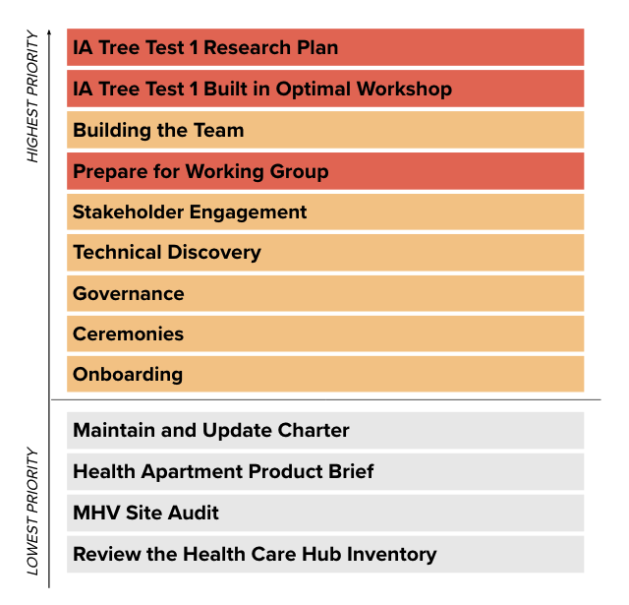
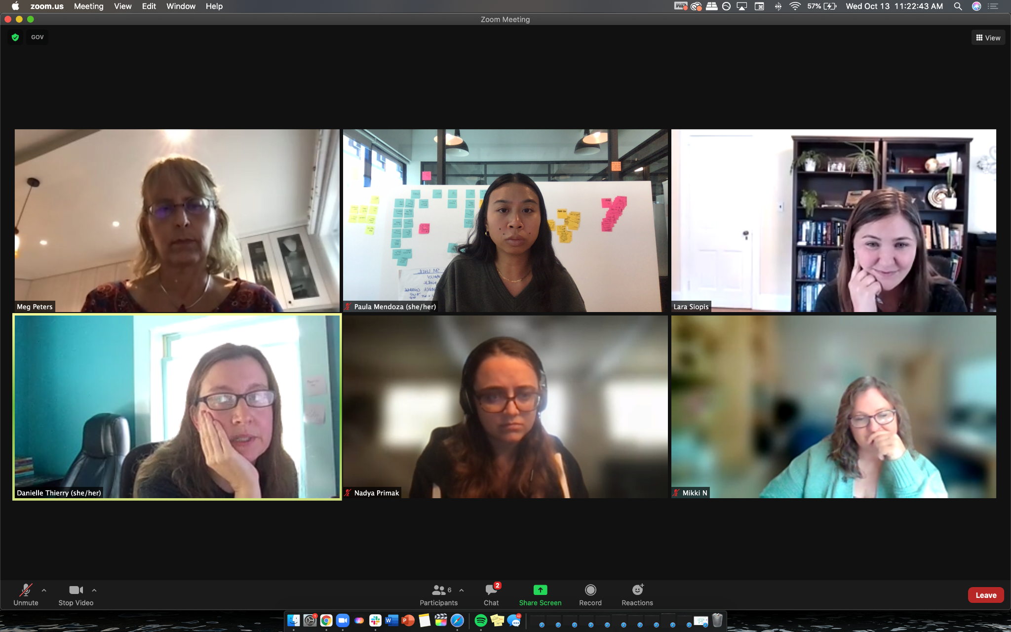
End of Sprint 2 Update
CLIN 0001AB
Sprint 2 focused on designing the research plan, preparing for the Working Group, and wrapping the first cycle of technical discovery, among other goals.
Building off the momentum from Sprint 1, we used our newly built Zenhub backlog to track our progress towards sprint deliverables. We collaboratively further refined the research plan and developed the tree test in Treejack. Our various introductions / conversations with key partners from other teams helped to shape our understanding of the POC. Team feedback and reflection helped us continue to strengthen our process and workflow in real time.

Slide 32
End of Sprint 2 Update (1 of 2)
CLIN 0001AB
The team’s accomplishments this sprint include:
Deep Dive into Research, Discovery, and Proof of Concept
Created the agenda and discussion guide for technical discovery sessions on 10/6.
Conducted and debriefed initial technical discovery session with Michael Chelen to learn about the VA.gov architecture and identify the additional resources, relevant systems, and people that are critical to delivering the POC on 10/7.
Scheduled technical discovery sessions on 10/7.
Created the process for downloading, storing, and conducting synthesis on notes and learnings from discovery discussions on 10/7.
Got write access to VA.gov repos and created new section for health-apartment in va-gov.teams on 10/5.
Began creating the research plan to test the IA and discoverability of content within the Apartment on 10/7.
Updated technical discovery discussion guide in preparation for our meeting with Cory Trimm, the Director of Engineering at OCTO on 10/12.
Conducted technical discovery and introductory meeting with Cory Trimm, learned about VA.gov data and identity and sharing our approach to discovery on 10/12.
Met with Mikki Northuis (Information Architect) and Danielle Thierry (Sitewide Content Lead), made introductions and discussed maintenance and minimization of content and design debt 10/13.
Conducted and debriefed introductory meeting with Dave Conlon (Crew Chief, Public Website), showed the Apartment wireframes and learned more about how to engage the Public Website team on 10/13.
Added issues to the backlog based on technical discovery sessions, including API research, CERNER and Community Care downloads, and Content, Auth, and Navigation downloads, on 10/14.
Synthesized all notes from previous technical discovery sessions and updated our technical discovery mural with key learnings, risks, assumptions, and questions on 10/14.
Documented the current state of our technical discovery findings into a summary on Github outlining our research questions, key findings, who we’ve talked to, recommendations, and further research needed on 10/15.
Co-created and developed the research plan in GitHub on 10/13-10/15.
Converted existing site map into excel format and uploaded it into Optimal Workshop, developed tasks, and built the Treejack test on 10/13-10/15.
Onboard Landing Team and Kickoff Project
Established weekly Problem Solving sessions with MO leadership to provide guidance and steering on 10/6.
Conducted PM Orientation with Shira, learning more about the collaboration cycle and how to engage with the Platform team on 10/7.
Attended Identity Working Group session on 10/7.
Conducted SteerCo meeting with Lauren on 10/7.
Synthesized research from working group sessions on 10/13.
Conducted Apartment Working Group co-creation session with Meg and Lauren to align on objectives on 10/14.
Created Apartment Working Group agenda and materials for review on 10/15.
Attended Mobile Flagship App Sync and Identity Working Group sessions on 10/14.

Slide 33
End of Sprint 2 Update (2 of 2)
CLIN 0001AB
The team’s accomplishments this sprint include:
Problem Definition, Approach, & Sprint Planning
Conducted Sprint 2 Kickoff to launch the sprint aligned on sprint goals (below), priorities, and deliverables, clarify responsibilities, and raise and mitigate risks on 10/6.
Prepared slide for Team of Teams, reviewed with Liz and Jeff S., and presented to Team of Teams on 10/5.
Prepared the Team of Teams slide and conducted a review cycle prior to the Team of Teams meeting on 10/12.
Attended the Team of Teams meeting and presented team updates to the ecosystem on 10/12.
Rescheduled Sprint 2 Demo due to the OCTO offsite on 10/12.
Conducted Backlog Grooming on 10/13.
Conducted Sprint 3 Planning, aligning on high priority goals and epics, on 10/14.
Recruiting, Hiring, and Onboarding
Drink, Nadya, and Jared completed fingerprinting on 10/4-10/7.
Interviewed 3 UX Lead candidates on 10/4-10/7.
Extended an offer to 1 UX Lead on 10/7.
Submitted first monthly Contract Program Management Plan on 10/7.
Scheduled monthly Contractual Reporting Session on 10/7.
Attended Meeting to Discuss FAR 52.223-99 Ensuring Adequate COVID-19 Safety Protocols for Federal Contractors (OCT 2021) (DEVIATION) for CEDAR on 10/13.
Signed and returned Contract Mod on 10/13.
Conducted Contractual Reporting Session to discuss the program, address risks, and review the monthly project management plan on 10/13.
Paula completed fingerprinting on 10/14.
Revised and posted Product Manager Job Description on 10/12
Added 1 product manager candidate to the pipeline 10/13
Added 1 Visual Designer to the pipeline 10/13
Interviewed 1 lead for UX designer 10/14
Completed Drink, Jared, Nadya, and Paula's fingerprints, pending adjudication to begin security clearance process 10/12-10/15
Conducted working session to develop onboarding strategy and execution plan for onboarding new hires onto team on 10/15.

Slide 34
Sprint 2 Links to Work
CLIN 0001AB
IA Tree Test Research Plan
Link here.
IA Tree Test in Treejack
Link here.
Working Group Preparation
Working Group research synthesis and co-creation here.
Technical Discovery
Technical discovery synthesis here.
Technical discovery Mural notes here.

Slide 35
Sprint 2 Acceptance
CLIN 0001AB
Sprint Goals
High: Develop a research plan and identify, prepare, and review all resources needed to conduct IA testing. Continue building the team. Start preparation for the Apartment Working Group session. Conduct introduction and knowledge transfer sessions with the Account team (10/18), Identity team (10/25), and Sitewide team (10/13).
Medium: Create version of existing wireframes in Sketch to use for testing and initial POC environment setup. Build and maintain awareness of the modernized VAMC products. Continue technical discovery. Begin creating the roadmap by layering in the information we have up to this point
Focused Epics
IA Tree Test 1: Research Plan & Build in Optimal Workshop
Building the Team
Prepare for Working Group
Stakeholder engagement
Technical Discovery
Governance
Ceremonies
Onboarding
Deliverables
Name / Description | Acceptance Criteria
IA Tree Test Research Plan | Approved research plan ready for recruitment Research plan will be ready for review and approval by end of sprint rather than approved for recruitment.
IA Tree Test | Tree test designed and built in Treejack
Recruiting Update | Staff roster maintained and updates included in reporting
Working Group Preparation | Team has co-created and prepared for an engaging working group session
Stakeholder Engagement | Meetings with Account, Sitewide and Mikki and Danielle conducted
Technical Discovery | Meetings with Mike Chelen and Cory Trimm conducted
Contract Onboarding / Governance | Contract reports provided on time GitHub repo setup in Healthcare with proper IA Apartment updates are presented at ToT

Slide 36
Show me, don’t tell me: Sprint 3 Demo
2 November 2021

Slide 37
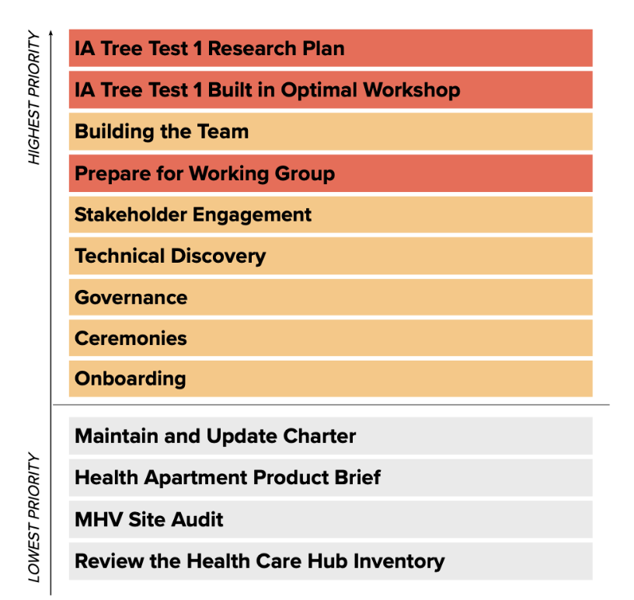
Sprint 3 Approval
CLIN 0001AB
Sprint Dates: 10/20/2021-11/2/2021
Sprint Goals
High: Conduct the first Apartment Working Group and follow-up with actions. Obtain approval for the IA Tree Test 1 Research Plan and Materials. Begin recruiting for the IA Tree Test 1. Create an Apartment Product Outline. Continue to build the team.
Medium: Continue knowledge transfer. Understand the auth/unauth pathways. Continue technical discovery, specifically API research and access to the MHV repo.
Focused Epics
Conduct First Apartment Working Group
Obtain approval for IA Tree Test 1
Recruit for IA Tree Test 1
Conduct IA Tree Test 1
Create Health Apartment Product Outline
Building the Team
Downloads: CERNER, Community Care, Content and Auth, Navigation
Technical Discovery
Stakeholder engagement
Governance
Ceremonies
Onboarding
Deliverables
Name / Description | Acceptance Criteria
Working Group | Working group session conducted Follow-up actions completed
IA Tree Test | Approved research plan ready for recruitment documented in GitHub Tree test recruitment launched Tree test initiated with participants
Stakeholder Engagement | Meeting with Identity team conducted Mobile, Auth, DHM cross team sync attended
Downloads | CERNER, Community Care, Content and Auth, Navigation downloads conducted

Slide 38
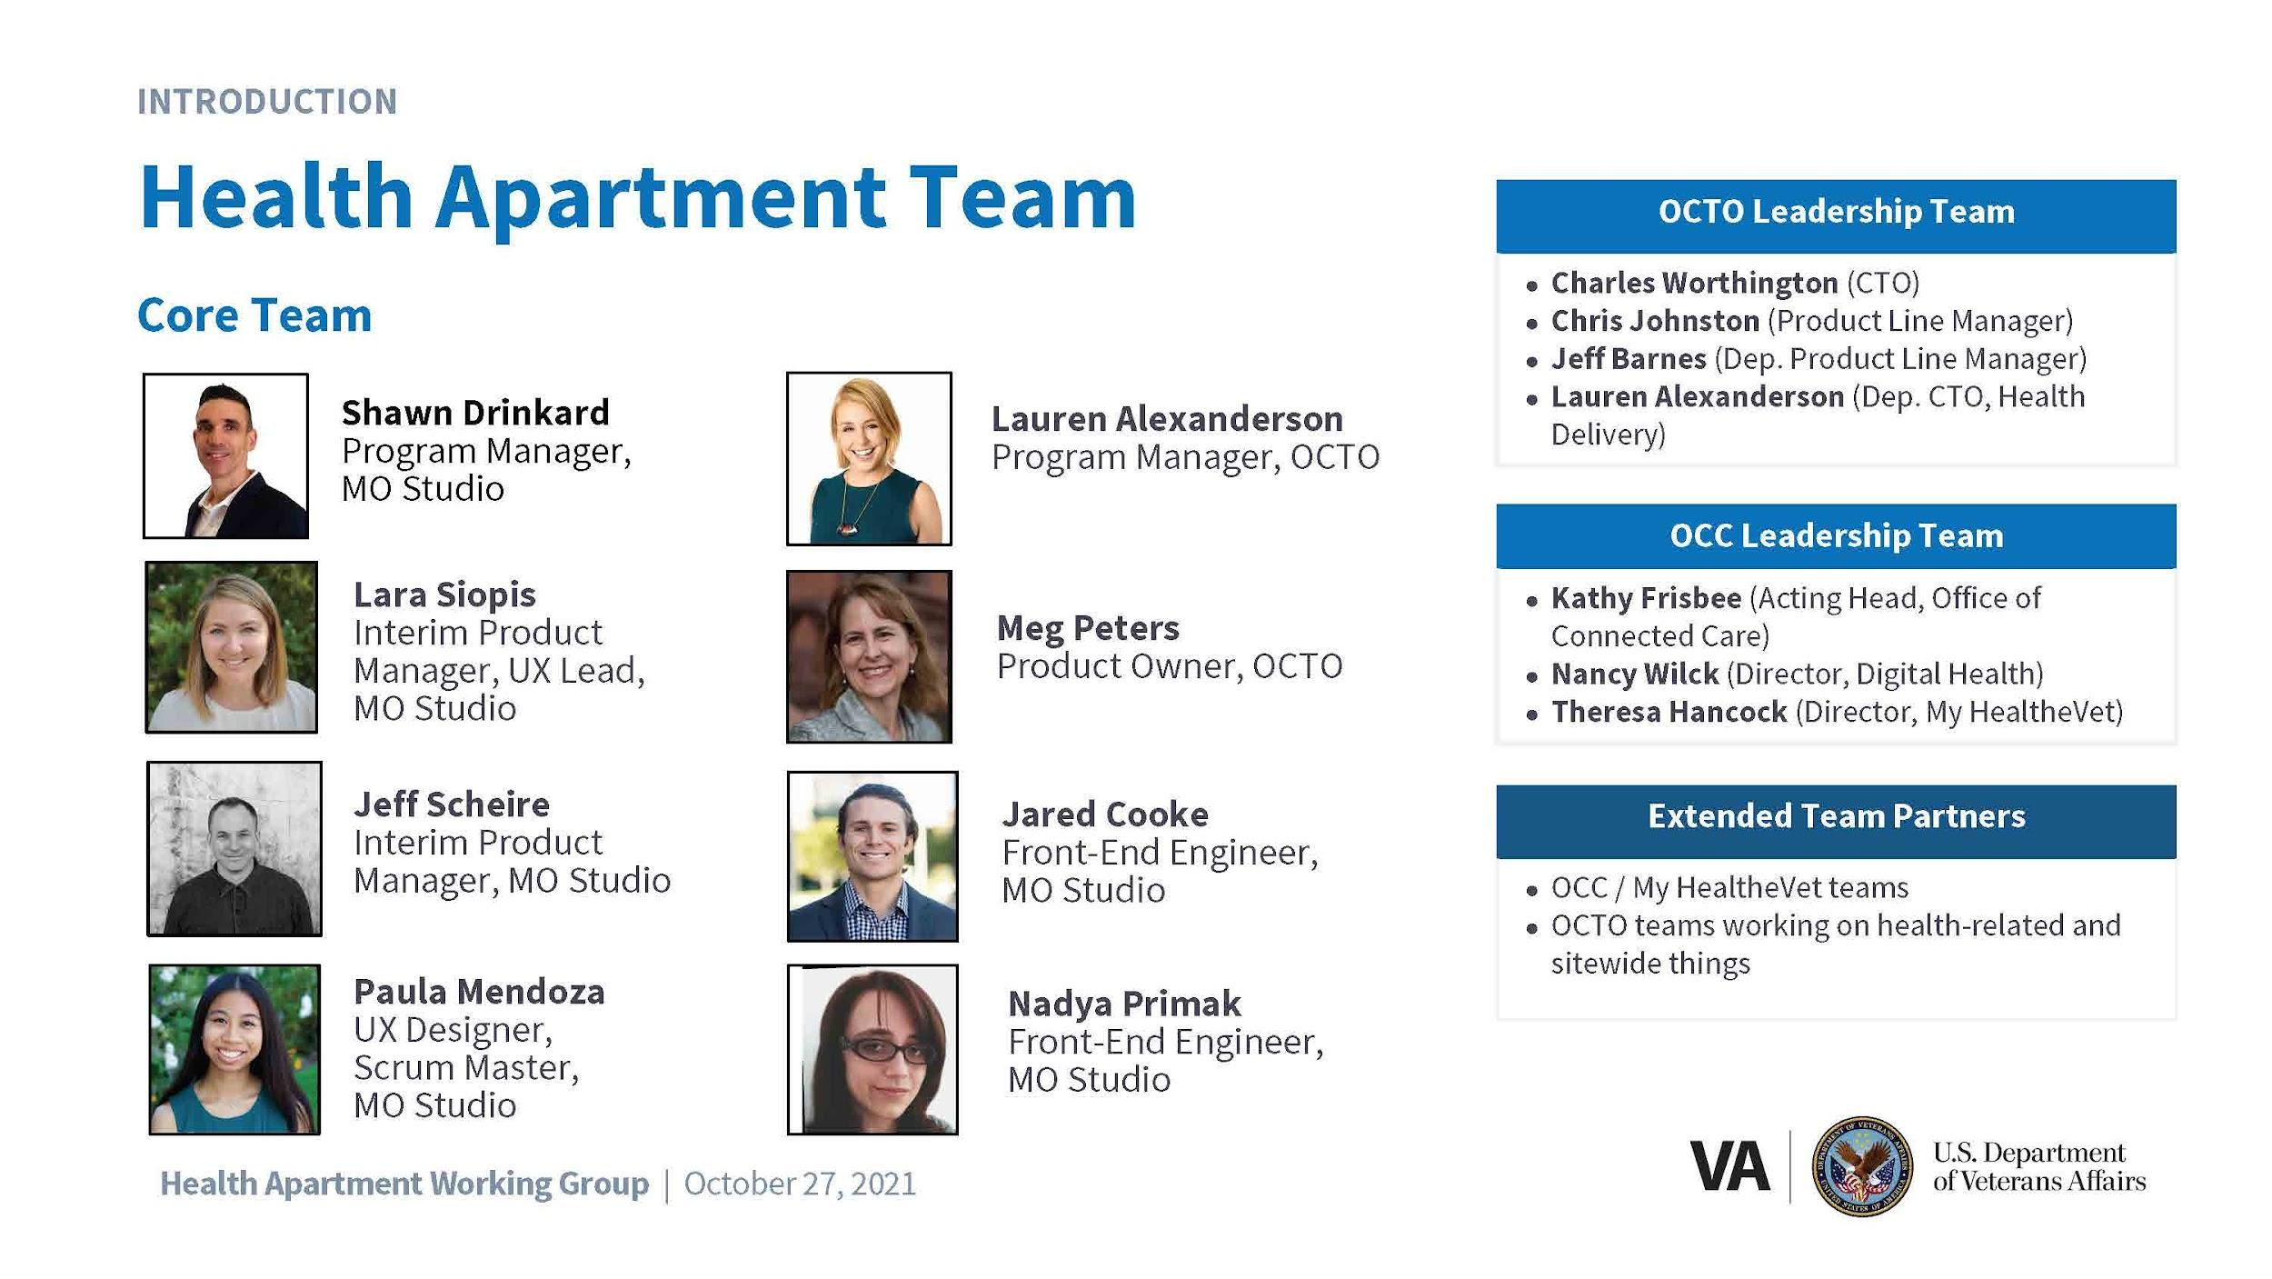
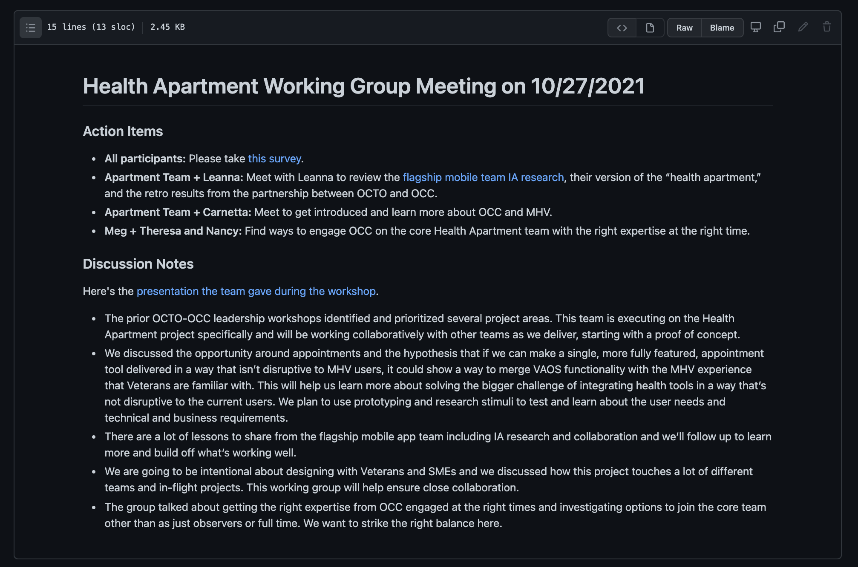
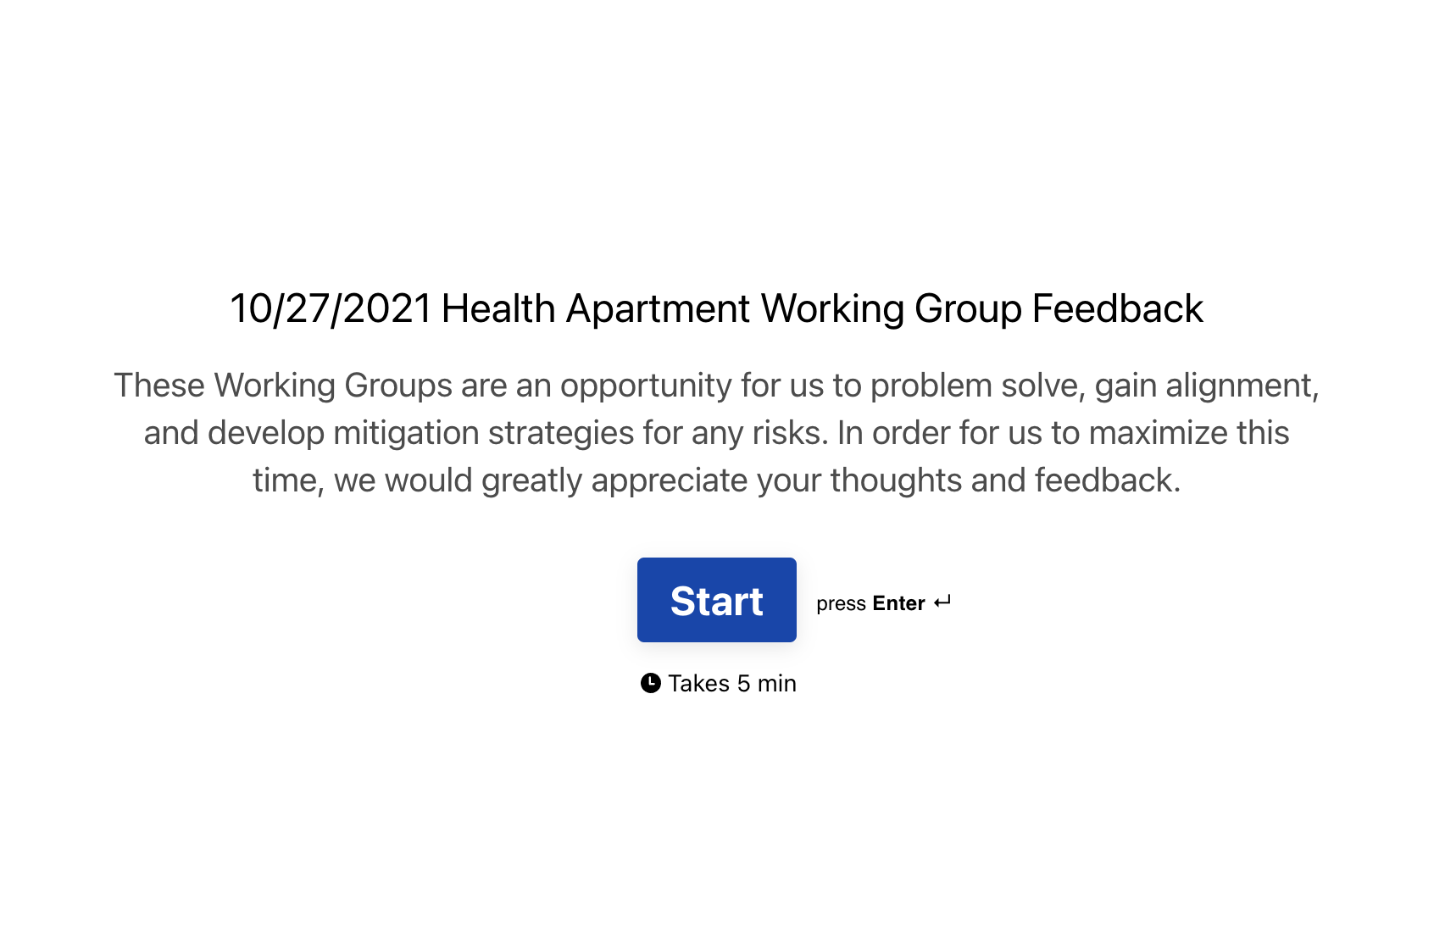
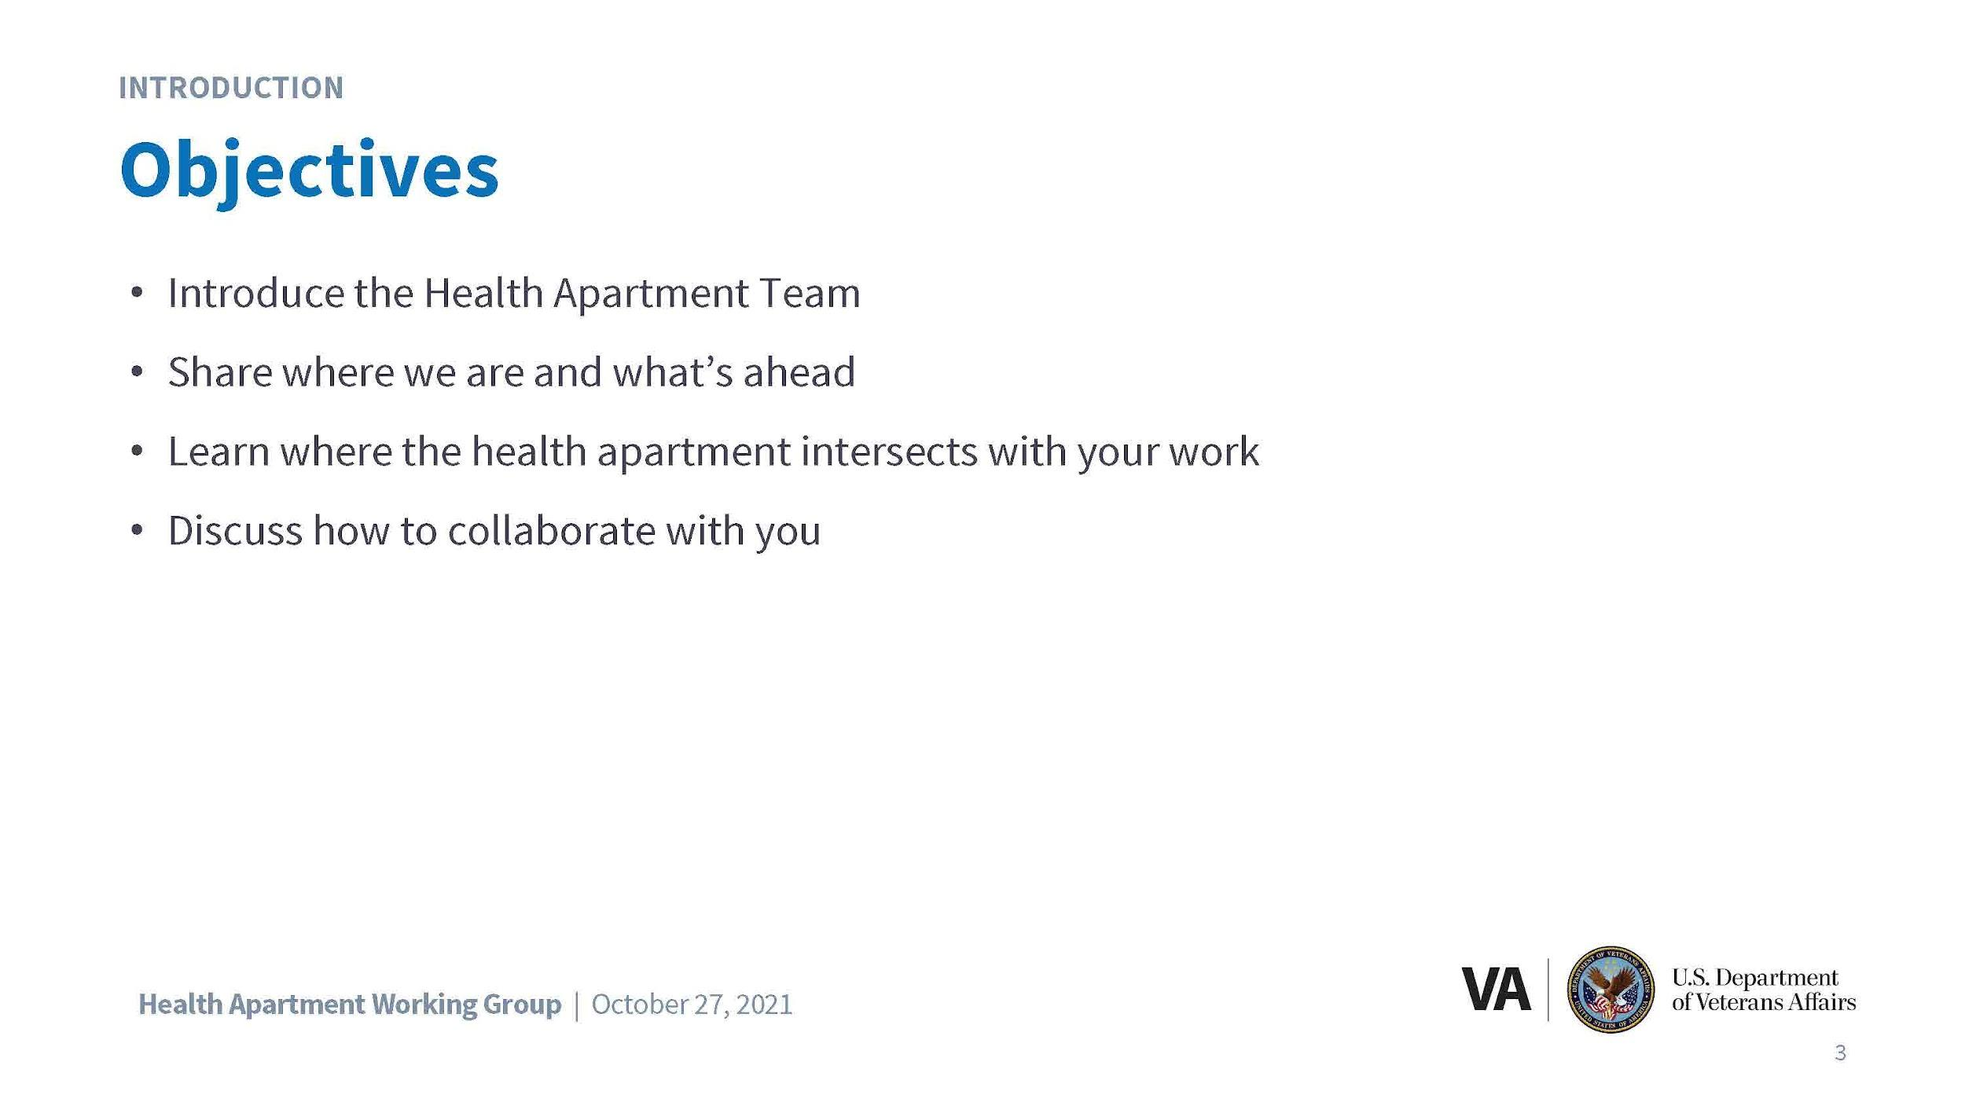


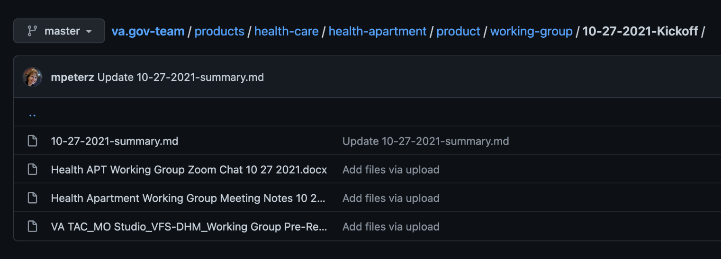
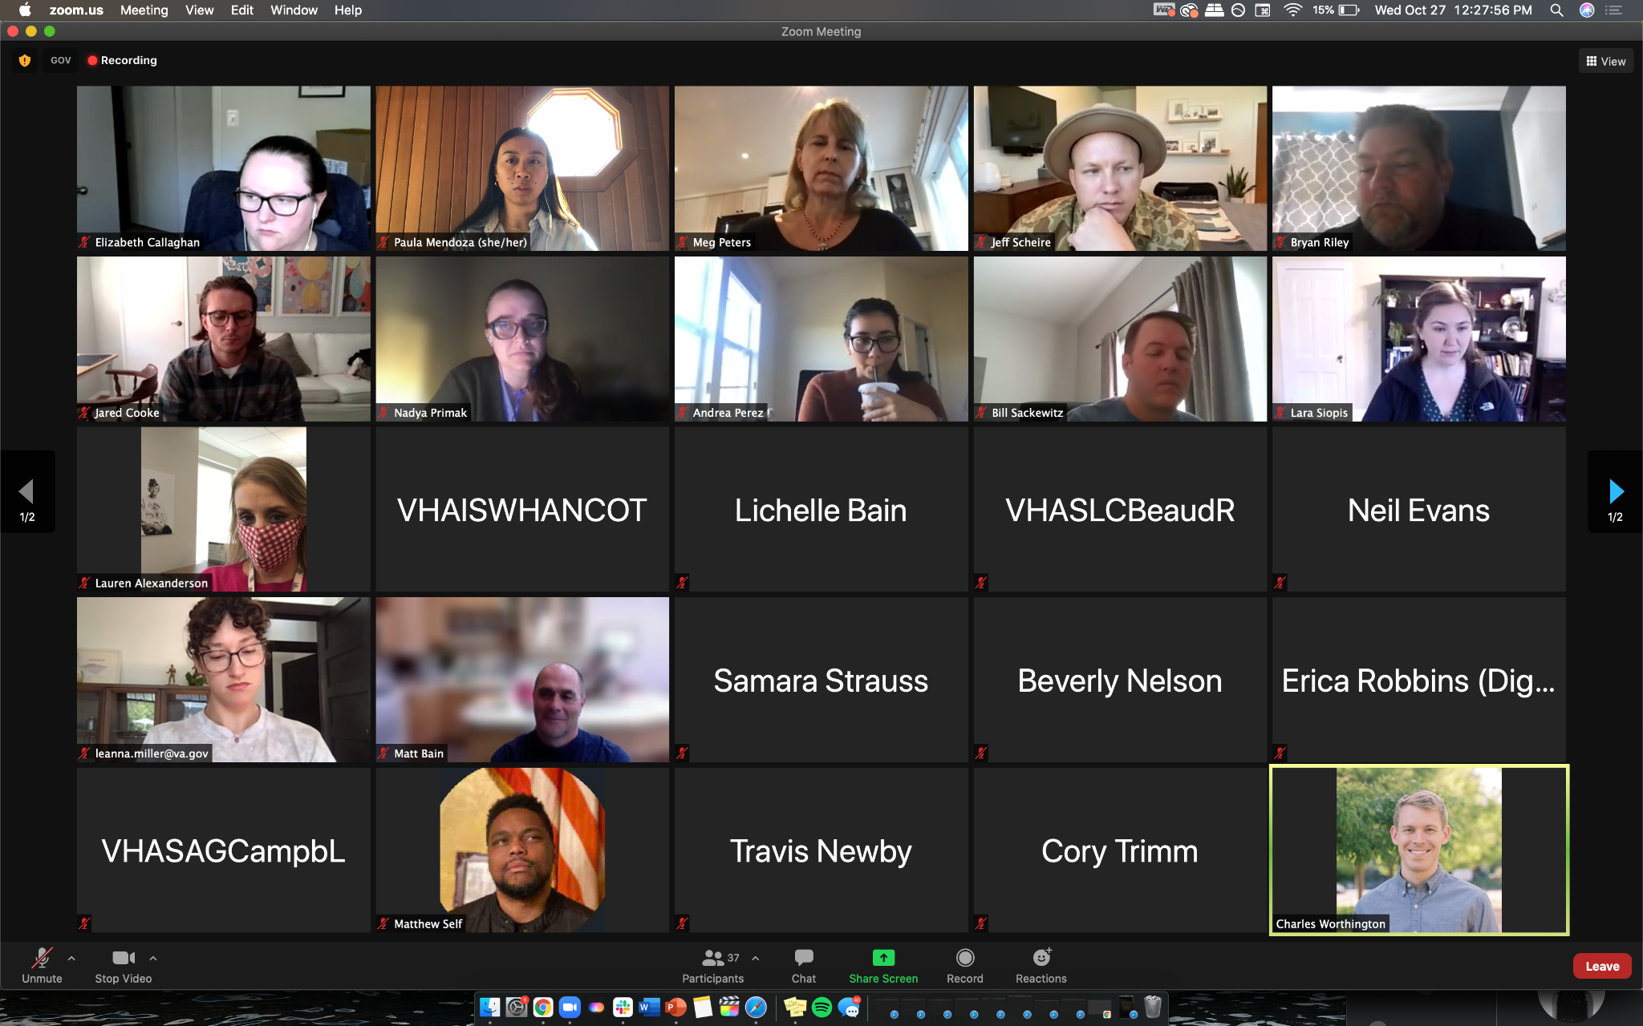
First Apartment Working Group
CLIN 0001AB
Conducted Apartment Working Group #1 with OCTO and OCC.
Accomplished objectives, including: (1) introduced our new Health Apartment Team; (2) shared how we got here, work to date, and what’s ahead; (3) continued to learn how our work builds off and impacts other teams’ work; (4) shared our vision for collaborating
Captured and distributed meeting minutes, follow-up email, gathered feedback via survey, and engaged OCC stakeholders in follow ups / action items.
Materials
Notes
Survey
GitHub Repo
Working Group
View the materials, notes, and survey results here.

Slide 39
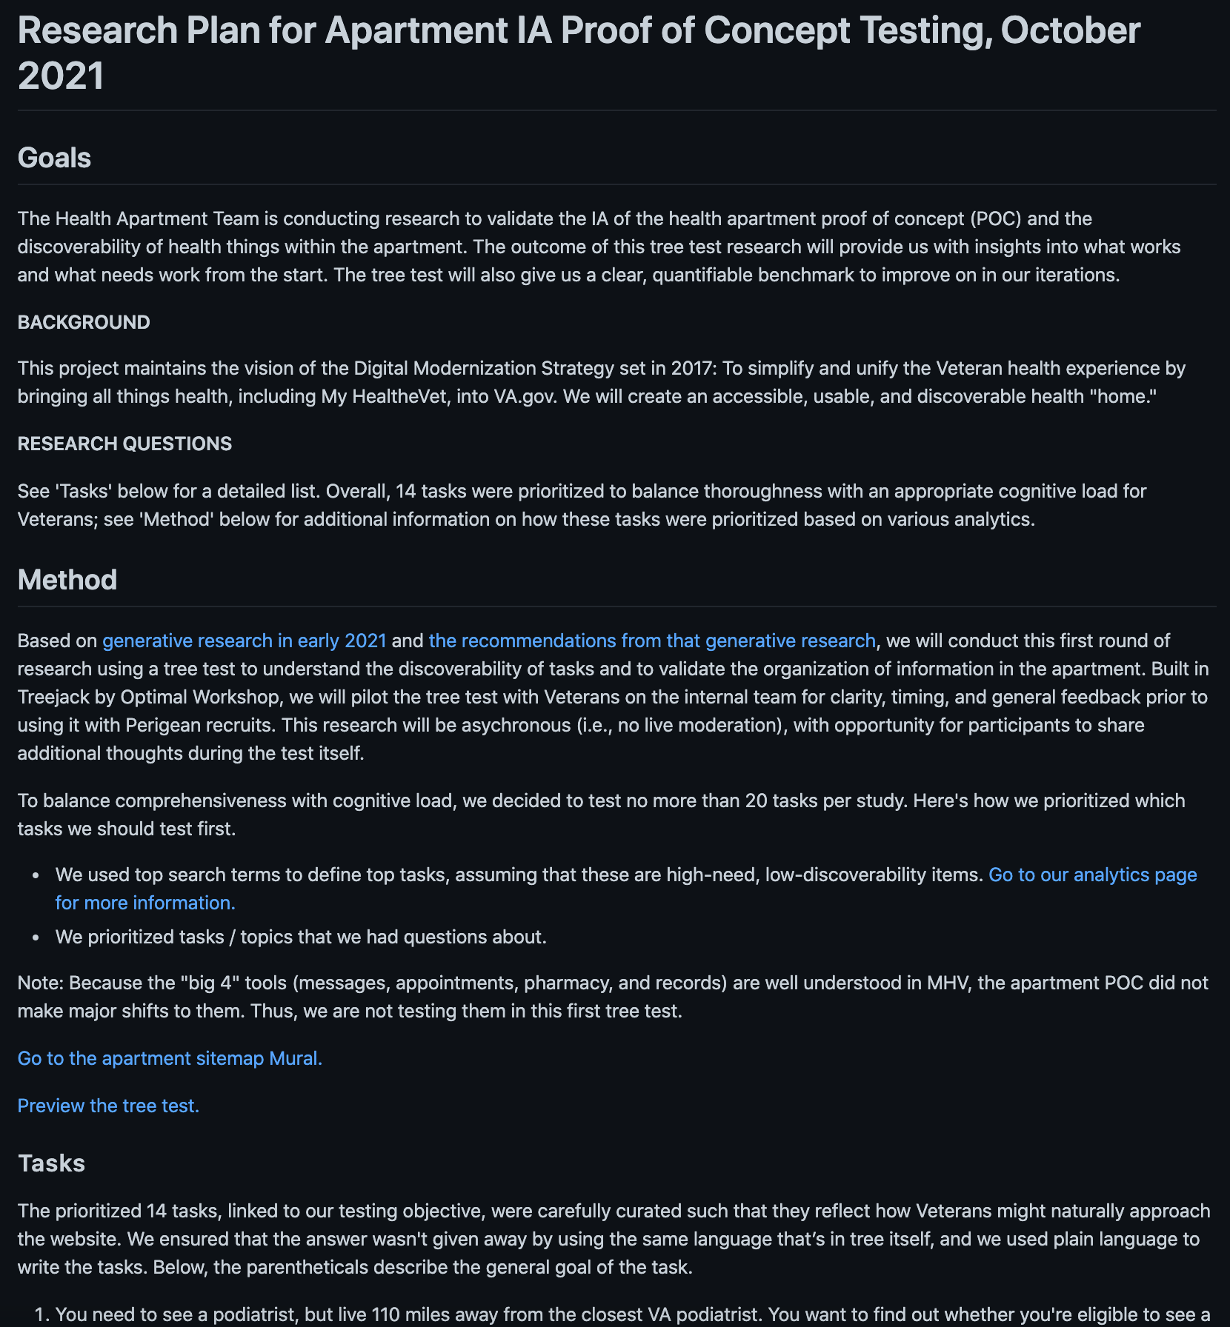
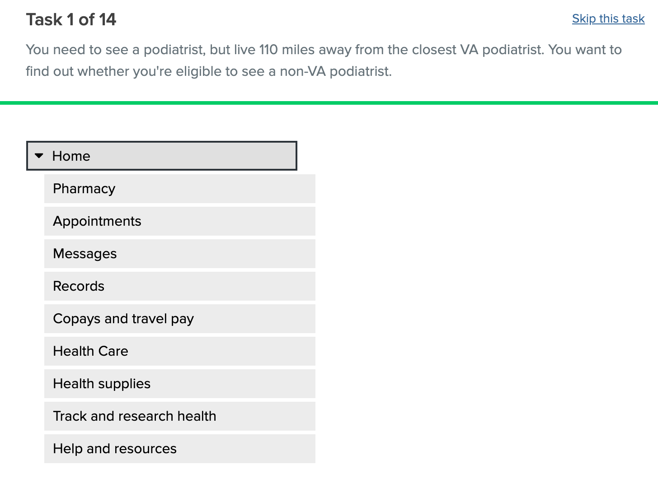
IA Tree Test
CLIN 0001AB
Updated recruiting method and segments.
Iteratively co-created research plan and IA tree test to validate the IA of the POC and the discoverability of health things within the apartment.
Conducted leadership review cycles, iterated to final tree test, and obtained leadership approval.
Submitted recruiting request to Perigean and officially launched tree test.
Created a Slack group with Perigean, COR, and team to manage tree test.
Began testing with 2 of 5 segments and will continue to proactively manage / communicate with Perigean each day on used codes.
Research plan
Treejack test
View the research plan here.
Preview the treejack test here.

Slide 40
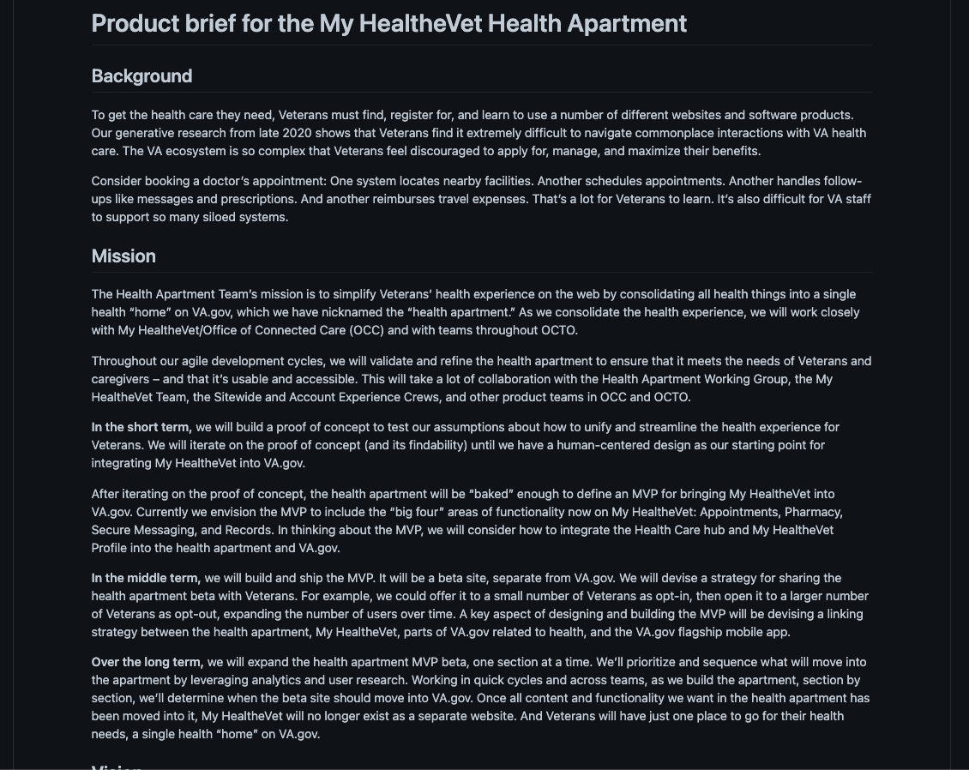
Health Apartment POC Outline
CLIN 0001AB
Drafted the Health Apartment product outline in GitHub and distributed to team feedback and iteration.
Used the Platform team’s template to speed up time to impact.
Planning to kickoff the Collaboration Cycle, using this artifact to share our design intent with the Platform team.
POC Outline
View the Health Apartment POC outline here.

Slide 41
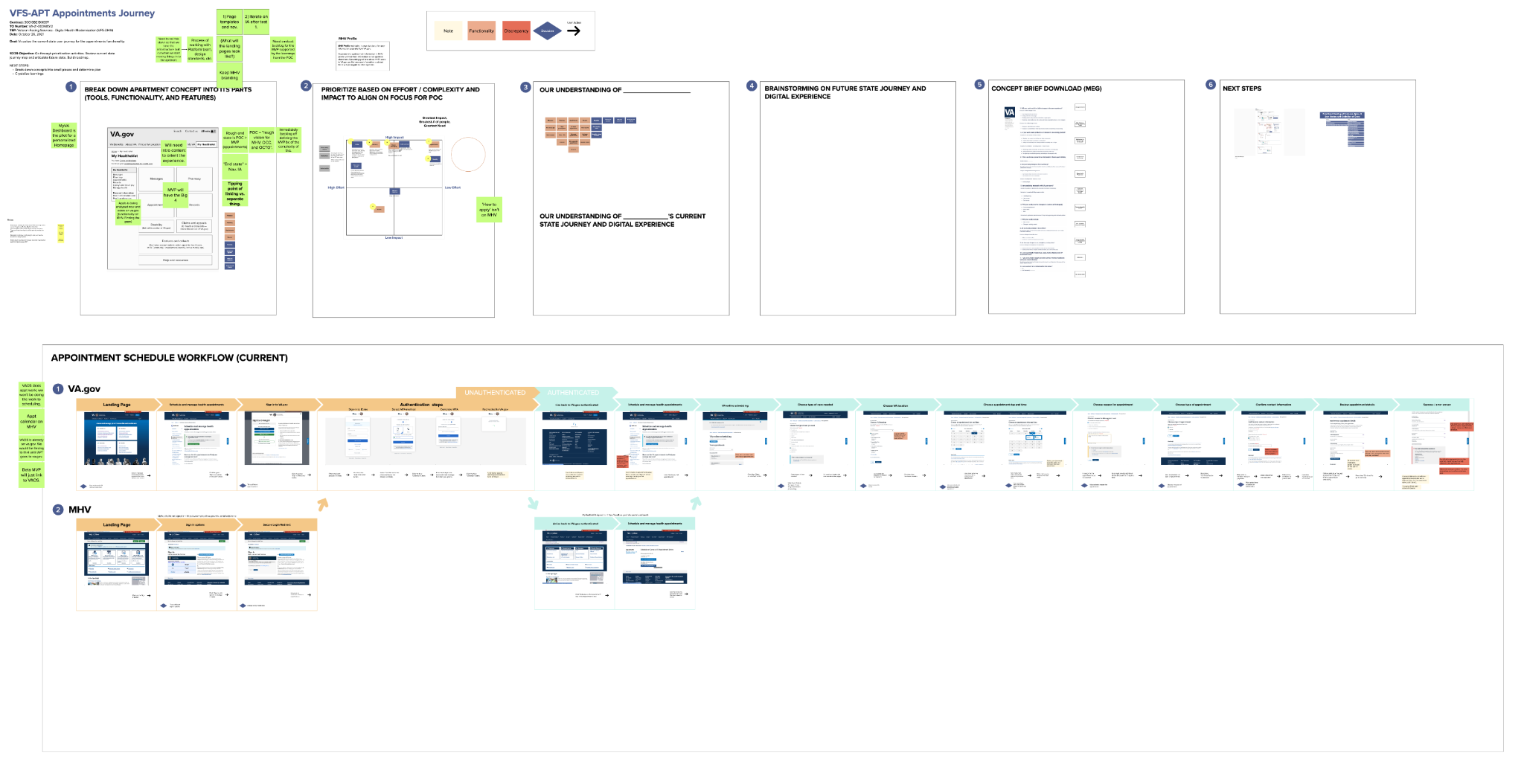
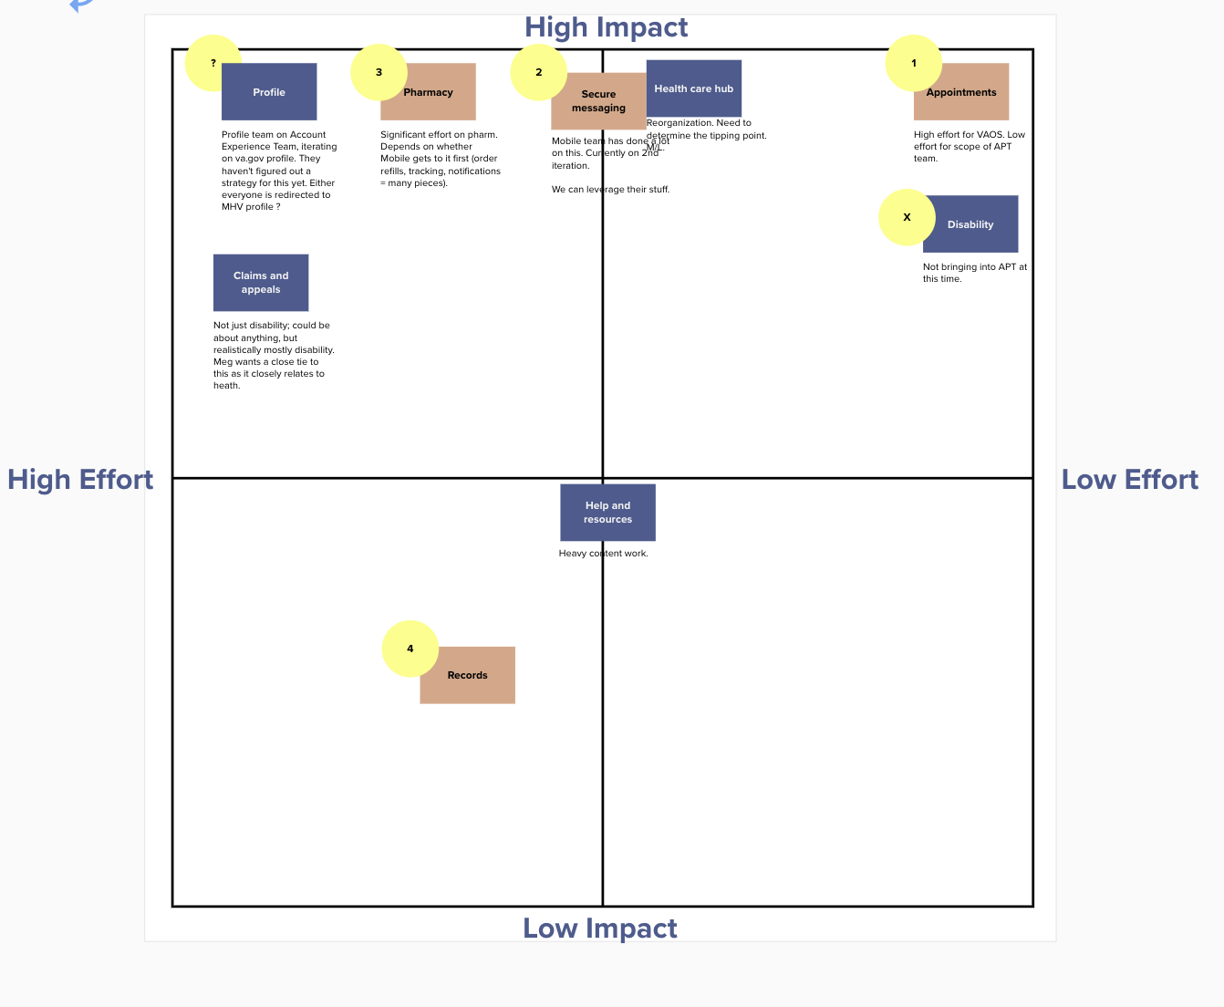
Health Apartment POC Co-Design Workshop
CLIN 0001AB
Mapped current state Veteran journey for appointment scheduling through VA.gov and My HealtheVet.
Created iterative / micro workshops to move from vision / concept to prioritized components; aligned on initial component set for POC design and teased out inputs to sequence product strategy.
Identified components which can be built fastest with highest impact on Veteran experience.
Used current state journey as a diving board for discussion, idea exploration, cross team impacts, and alignment on bounds for POC design—gained clarity on what building the appointments component will entail.
Looking ahead, identified 4 major components which will exist in MVP.
POC Co-Design Workshop
View the working session Mural board here.

Slide 42
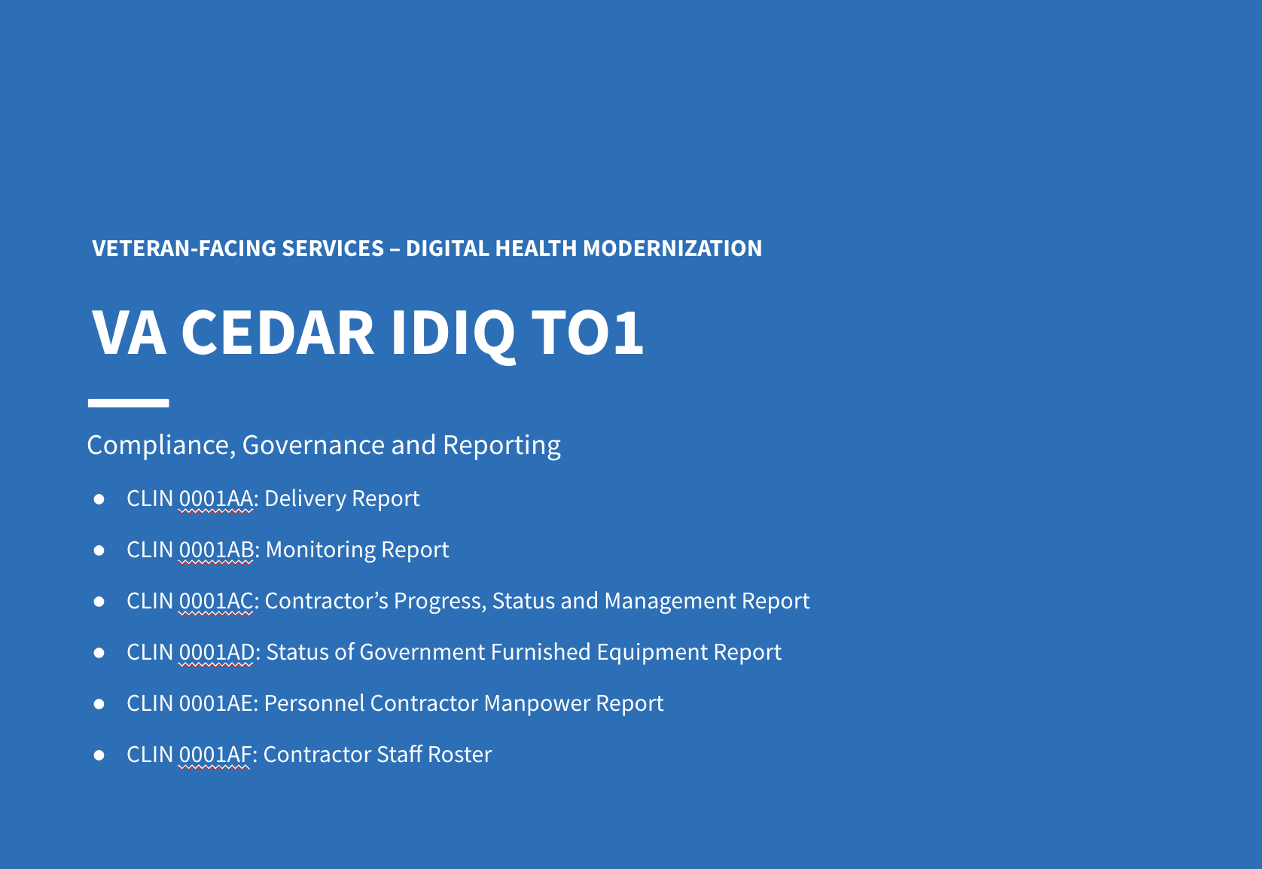
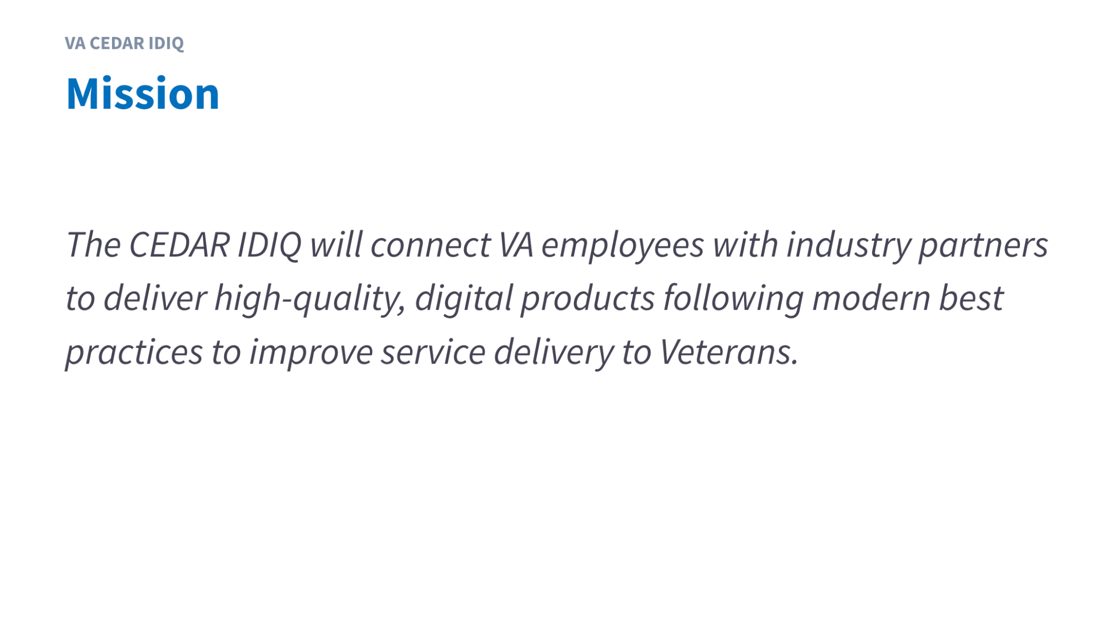

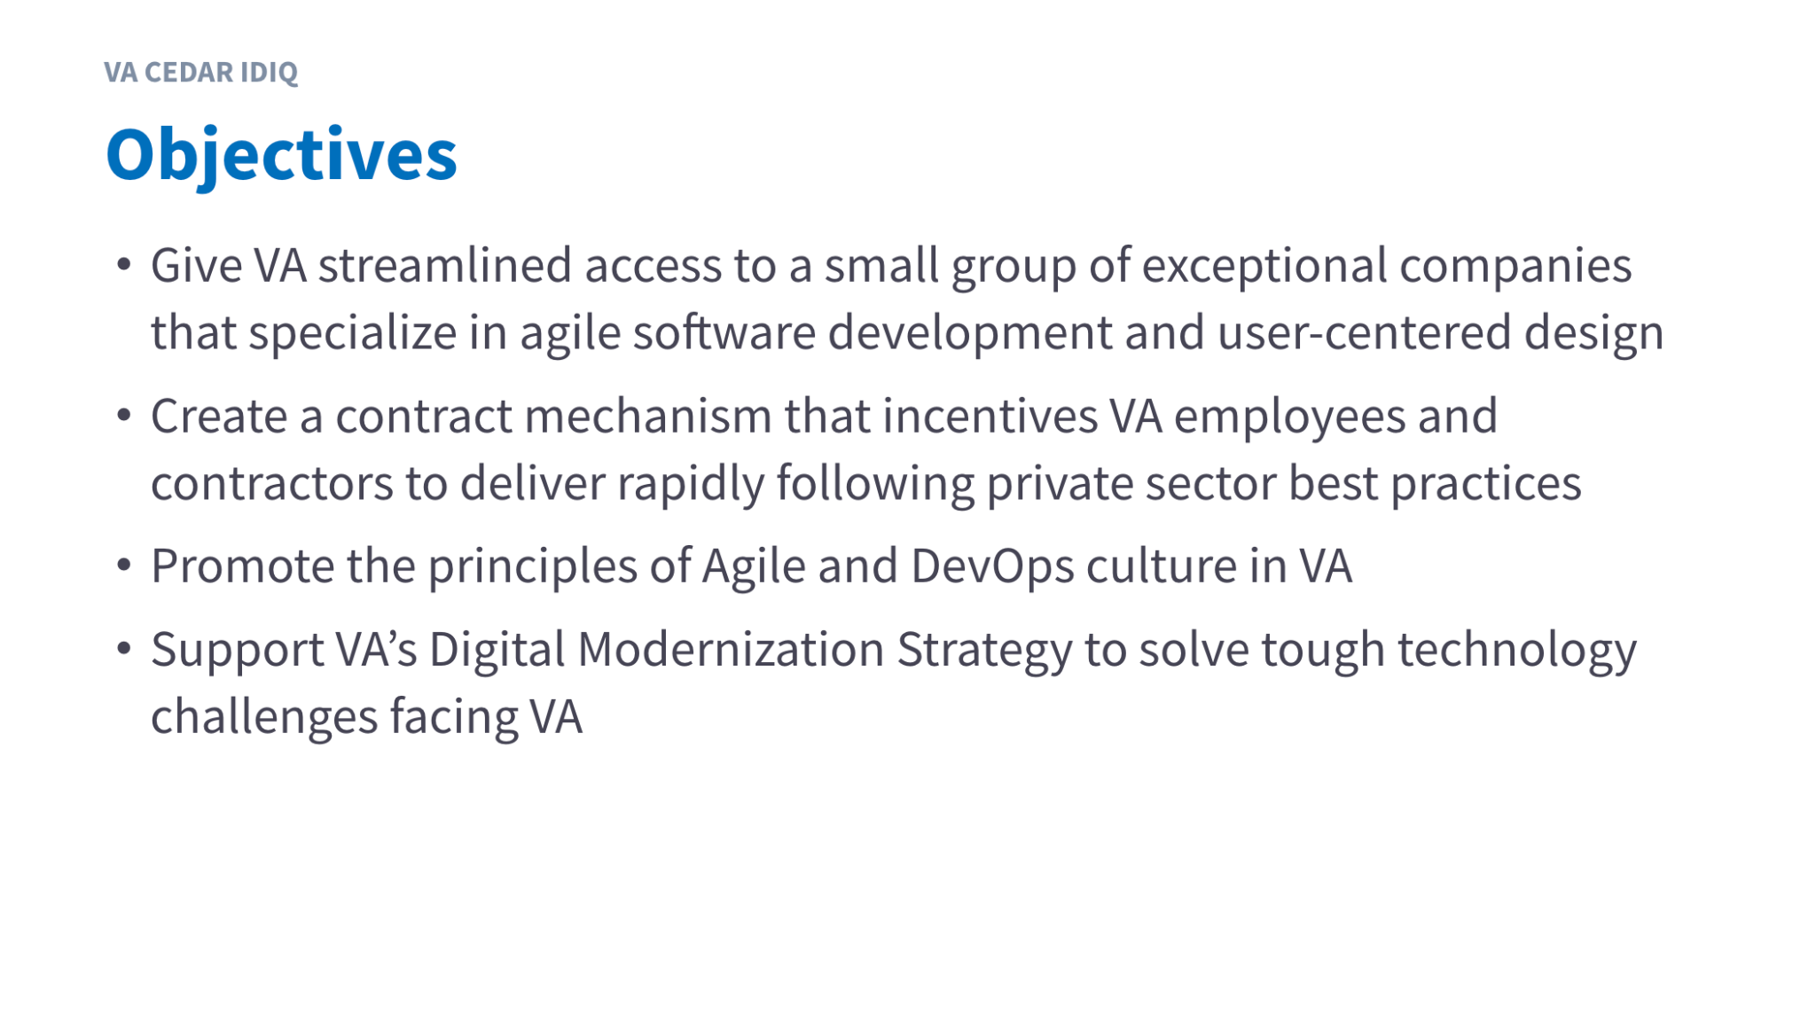
Governance
CLIN 0001AB
Designed materials and conducted initial CEDAR IDIQ and Health Apartment monthly governance and reporting meeting.
Engaged Exec Sponsor, PO, COR, and TAC COs to address contractual requirements.
Identified opportunities to use governance materials across CEDAR task orders.
Identified opportunities to improve transparency and communications on risks and mitigation strategies.
CEDAR IDIQ and Health Apartment Monthly Reporting
View the CEDAR IDIQ and Health Apartment October Monthly Report here. November coming this week!

Slide 43
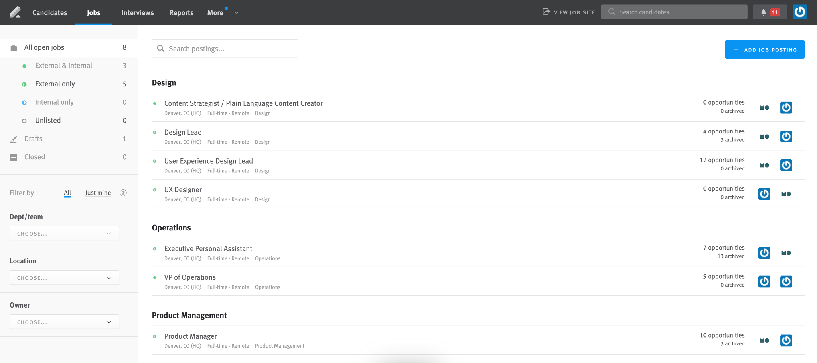
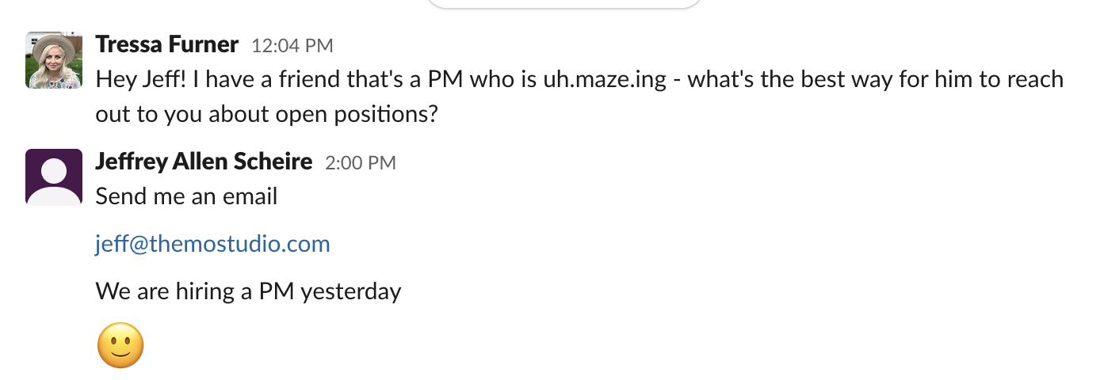
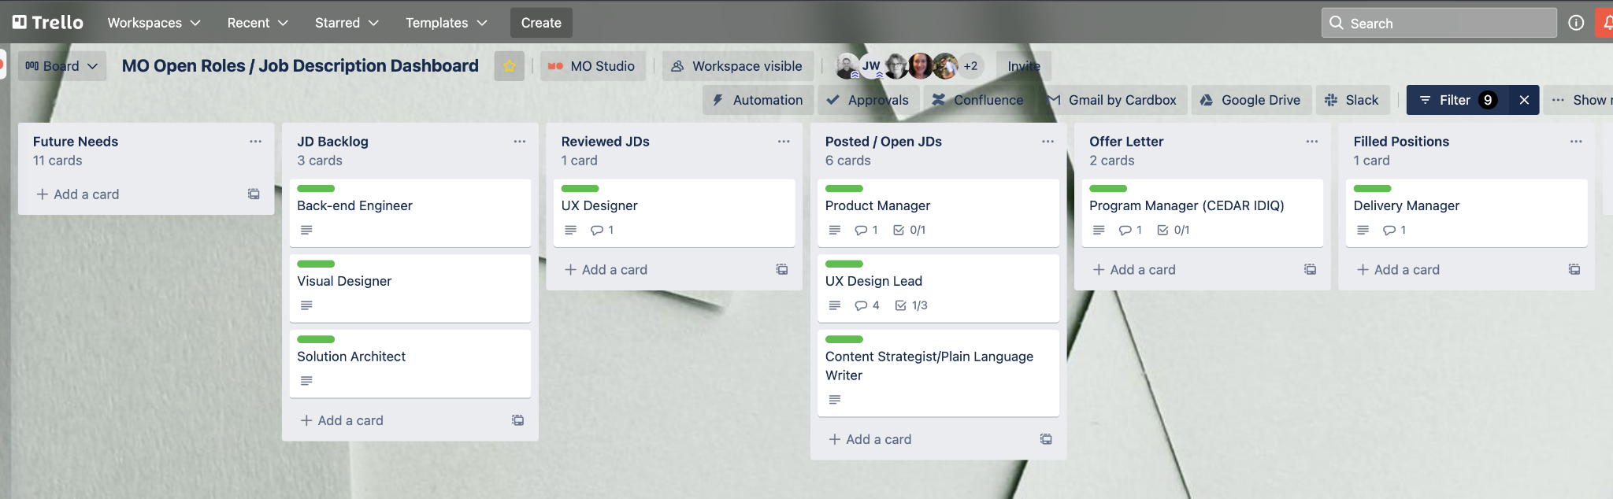
Building the Team
CLIN 0001AB
Aligned with Product Owner on design competencies needed on core team and prioritized focus / JDs.
Launched Lever (Candidate Management System), integrated LinkedIn and WordPress, posted JDs, conducted targeted outreach, and practiced vulnerability by engaging OCTO ecosystem and asking for help.
Moved candidates through the funnel: conducted interviews—(X) Delivery Manager, (XX) UX Design Lead, (XX) UX Designer; extended 4 offer letters: Health (1) Apartment Delivery Manager, (1) Health Apartment Product Manager; (2) CEDAR IDIQ Program Manager.
Created dashboard to openly and transparently provide visibility into open roles / JDs.
Engaged with CEDAR IDIQ teaming partners to staff open JDs.
Lever Candidate Pipeline
Pounding the Pavement
Trello Candidate Dashboard
View the Trello Open Roles / JD Dashboard here.

Slide 44
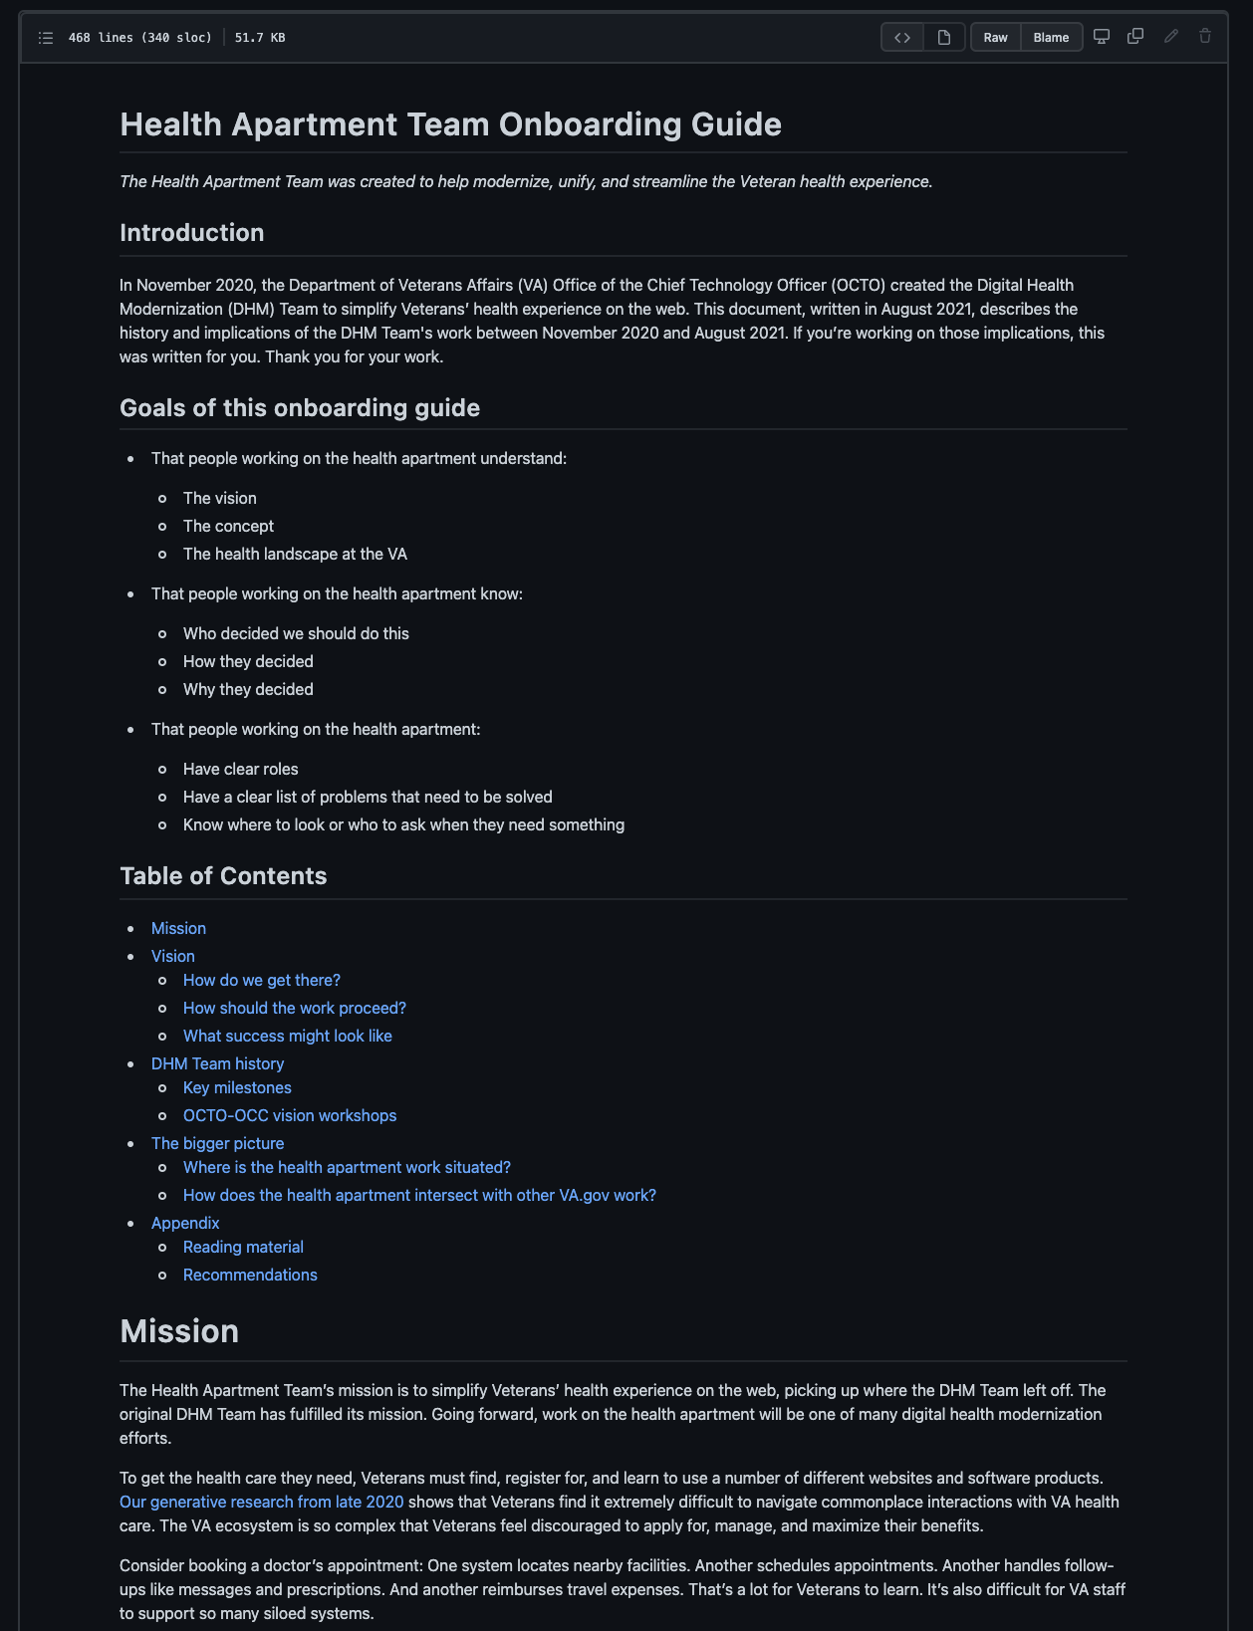
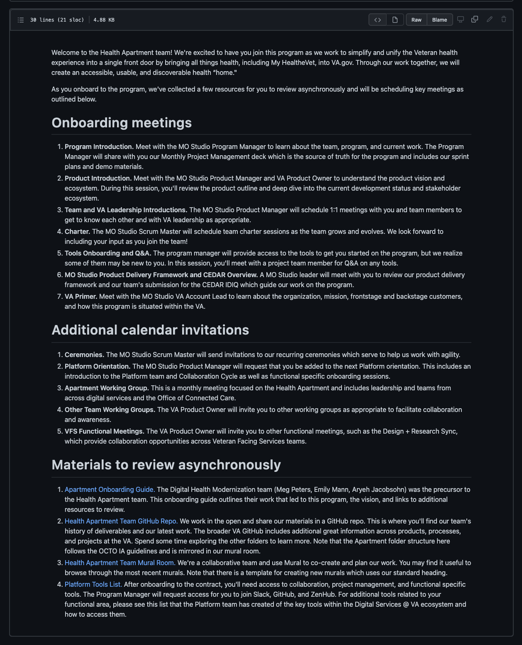
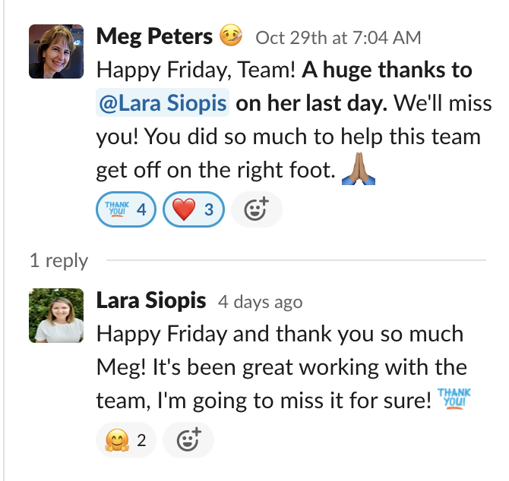
Offboarding and Onboarding the Team
CLIN 0001AB
Conducted onboarding with Heather Vujovich (MO, Delivery Manager) and Tami Corson (ServeAdvisory, Project Manager / Clinical SME).
Added Tracey Mulrooney (OCTO Product Owner) to Scrum meetings.
Mapped onboarding experience for new hires and subcontractors.
Created, tested, and iterated prototypes of Onboarding Guide and Onboarding Journey to address core CEDAR IDIQ pain point “how do we recruit, hire, onboard, and retain our team”.
Said goodbye to a key leader at MO, Lara Siopis.
Onboarding Guide
Onboarding Journey
Saying Goodbye
View the Onboarding GitHub readme here.

Slide 45

Ceremonies
CLIN 0001AB
Audited Agile ceremonies, identified opportunities to reduce meetings and empower team to focus on delivery, and made recommendations to PO.
Shifted sprint planning to beginning of sprint and consolidated with sprint kickoff, consolidated demo and retro, evolved retro into backlog prioritization with leaders (Exec Champion, PO, PM), and identified additional opportunities (e.g., right size and harden backlog to focus on leadership priorities—POC Design) starting Sprint 4.
Evolved calendar invites.
Monday | Tuesday | Wednesday | Thursday | Friday
11/1 | 11/2 POC and MVP Check-in: 9am ET Sprint 3 Demo & Retro: 11am ET Sprint 4 Backlog Prioritization: 2pm ET | 11/3 Admin / Fall Cleaning Monthly Contract PM Plan Update: 2pm ET | 11/4 Sprint 4 Planning: 10am ET | 11/5
11/8 | 11/9 POC and MVP Check-in: 9am ET | 11/10 | 11/11 | 11/12
11/15 | 11/16 POC and MVP Check-in: 9am ET Sprint 4 Demo & Retro: 11am ET Sprint 5 Backlog Prioritization: 12pm ET | 11/17 Sprint 5 Planning: 10am ET | 11/18 | 11/19
11/22 | 11/23 POC and MVP Check-in: 9am ET | 11/24 Apartment Working Group: 2pm ET | 11/25 | 11/26
11/29 | 11/30 POC and MVP Check-in: 9am ET Sprint 5 Demo & Retro: 11am ET Sprint 6 Backlog Prioritization: 12pm ET | Sprint 6 Planning: 4pm ET

Slide 46
End of Sprint 3 Update (1 of 2)
CLIN 0001AB
The team’s accomplishments this sprint include:
Apartment Working Group
Co-created Apartment Working Group objectives and agenda with Meg and Lauren and documented synthesis in GitHub on 10/18-10/20.
Drafted email to Apartment Working Group participants and sent out the objectives and agenda on 10/20.
Drafted and reviewed Apartment Working Group slides during MO Problem Solving sessions, getting feedback from MOVE leadership (reachback support across our CEDAR team) on 10/20.
Revised Apartment Working Group slides and shared with Meg and Lauren on 10/21.
Began to reconcile feedback on 10/22.
Kicked off the Apartment Working Group with our first session on 10/27. The work for this included co-creation with Meg and Lauren, presentation prep, gathering input from our CEDAR go to market partners, creating a participant survey, debriefing, and synthesizing key takeaways and action items.
Sent follow up email with notes, slides, and link to feedback survey.
Research and Discovery
Discussed using the MHV newsletter as a recruiting tool for the IA tree test if offered by OCC on 10/20.
Submitted IA tree test research plan for review by Meg and Lauren on 10/21.
Updated technical discovery tool (Mural) on 10/21.
Began to develop materials for research synthesis on 10/22.
Met with Ben to share learnings and get feedback on current technical discovery plan and developed a plan to limit the scope of the technical discovery sessions on 10/22.
Conducted debrief session immediately following our session with Ben to capture key learnings, actions items, and key questions to ask in the upcoming technical discovery sessions on 10/22.
Scheduled CERNER download session on 10/22.
Visualized the current state user journey for Appointments in Mural following a team member's actual experience through the process.
Met with Meg to deep dive into Navigation, Content, Authentication, Homepage design, Community Care, and Cerner creating a deeper shared understanding and capturing notes and additional references in Mural.
Launched recruitment for the IA Tree Test - our first phase of research on discoverability within the Apartment. Our research plan is in GitHub and the Tree Test can be previewed in Optimal Workshop.
Proof of Concept
Continued to synthesize learnings and POC definition in Mural on 10/19-10/21.
Followed up with Barry to request access to the MHV repo on 10/20.
Prioritized the use cases for the POC based on impact and level of effort.
Cross-team Collaboration
Attended Identity Working Group on 10/21.
Continuing to engage across OCTO teams with the VA.gov Platform and Apps Weekly Design + Content + Research Sync, Team of Teams, and Identity Working Group.
Met with the Identity team on 10/25.

Slide 47
End of Sprint 3 Update (2 of 2)
CLIN 0001AB
The team’s accomplishments this sprint include:
Recruiting, Hiring, and Onboarding
Aligned on hiring priorities with a focus on Product Manager, Design Lead, and UX Design Lead
Conducted staffing strategy sessions to discuss needed roles, anticipated gaps, and required skills on 10/19 and 10/21.
Revised and posted UX Design Lead Job Description on 10/22.
Conducted follow up interview with one Design Lead applicant on 10/22; total of 4 active applicants.
Continued PIV onboarding; next week we will submit security forms to VA SharePoint that will trigger EQIP, and make relevant modification to access.
Prioritized roles and skill sets to focus our hiring. Priorities are:
Product manager — top priority (This person might run scrum ceremonies.)
UX design lead
UX designer
RE: the 2 UX designers - Need these skills: user research (priority), service design (priority). Visual design skills needed, too.
Delivery manager (This person is a writer, communicator, organizer. Skilled in internal comms and product documentation. Not running the scrum.)
Content strategist + plain language writer (This person supports Meg in working on IA and content strategy.)
Back-end engineer (MO will probably pull from Pluribus for now.)
Approach and Sprint Planning
Conducted Sprint 3 Kickoff to launch the sprint aligned on sprint goals, priorities, and deliverables, clarify responsibilities, and raise and mitigate risks on 10/20.
Adjusted our sprint ceremonies to more efficiently prioritize and plan the work.
Added an administrative clean-up day to tackle any remaining onboarding tasks, access issues, or other recurring roadblocks.
Governance
Submitted Sprint 2 demo slides and links to work within the monthly report to minimize the creation of extra materials and received acceptance from Meg on 10/19.
Received approval for Sprint 3 on 10/19.
Invoiced Sprint 2 on 10/19.

Slide 48
Sprint 3 Acceptance
CLIN 0001AB
Sprint Dates: 10/20/2021-11/2/2021
Sprint Goals
High: Conduct the first Apartment Working Group and follow-up with actions. Obtain approval for the IA Tree Test 1 Research Plan and Materials. Begin recruiting for the IA Tree Test 1. Create an Apartment Product Outline. Continue to build the team.
Medium: Continue knowledge transfer. Understand the auth/unauth pathways. Continue technical discovery, specifically API research and access to the MHV repo. Added a medium priority goal during sprint kickoff to investigate Codepen for testing the Health Apartment IA with participants who use screen readers.
Focused Epics (Approval)
Conduct First Apartment Working Group
Obtain approval for IA Tree Test 1
Recruit for IA Tree Test 1
Conduct IA Tree Test 1
Create Health Apartment Product Outline
Building the Team
Downloads: CERNER, Community Care, Content and Auth, Navigation
Technical Discovery
Stakeholder engagement
Governance
Ceremonies
Onboarding
Deliverables
Focused Epics (Acceptance)
√ Conduct First Apartment Working Group
√ IA Tree Test (Obtain Approval, Recruit, Conduct)
√ Conduct Health Apartment POC Co-Design Workshop(s)
√ Create Health Apartment Product POC Outline
√ Build the Team, Onboard New Team Members, Built Prototype of Scalable Onboarding Process and Enabling Tools
√ Research—Technical Discovery, Downloads, and Stakeholder Engagement (CERNER, Community Care, Content and Auth, Navigation)
√ Monthly Governance and Reporting
√ Evolve and Optimize Agile Ceremonies
Name / Description | Acceptance Criteria
Working Group | √ Working group session conducted √ Follow-up actions completed
IA Tree Test | √ Approved research plan ready for recruitment documented in GitHub √ Tree test recruitment launched √ Tree test initiated with participants
Stakeholder Engagement | √ Meeting with Identity team conducted √ Mobile, Auth, DHM cross team sync attended
Downloads | √ CERNER, Community Care, Content and Auth, Navigation downloads conducted

Slide 49
Sprint 3 Retro
RETRO
Link here.

Slide 50
Show me, don’t tell me: Project Risks

Slide 51
CLIN 0001AB
Risks
Laying a foundation of trust between MyHealtheVet and VA.gov teams
Operating in an environment with multiple stakeholders with many layers of support
Ramping the team after Kickoff may impact team norming
Confusing Veterans regarding MyHealtheVet functionality while consolidating appointment functions
Reconciling the two different Terms of Service (ToS) across My HealtheVet and VA.gov
Mitigations
Respect the collaboration gains and create meaningful moments to
Create and maintain dynamic stakeholder matrix and RACI
Be super engaged and proactive with Champion SteerCo meetings
Stay in front of VSOs and TAP sources to impact habit patterns and collect secondary feedback
Work to consolidate ToS early to prevent Health Apartment from being blocked

Slide 52
Project Risks and Mitigation Strategies
CLIN 0001AB
Risk | Impact | Mitigation Strategy | Date Entered | Date Closed | Status
Operating in an environment with multiple stakeholders with many layers of influence and integration can lead to misaligned goals and competing priorities. | Misaligned goals and competing priorities. | Develop a deliberate and persistent omnichannel approach to stakeholder engagement that involves transparency and co-creation among crews and executive stakeholders. |  |  | Improved understanding with stakeholder session with Lauren on 9/20.
Onboarding the landing team, building in governance, recruiting and staffing open roles, and building the backlog and roadmap could lead to misaligned expectations across work streams. | Misaligned expectations on deliverables. | Communicate frequently and transparently. Align on the definition of done. |  |  | Monitoring
There are a lot of unknowns around the technical aspect of the POC. | Technical roadblocks could cause delays later in the program. | Build in time for technical discovery and research to identify the technical dependencies and highlight gaps that need to be addressed. |  |  | Monitoring
Potential for government shutdown. | Loss of access to VA team could lead to uncertainty on priorities, limited ability to remove blockers, and other delays. | Planned for work that could be done independently, but shutdown did not occur.
2 founding team members rolled off the program. | Loss of design, product, and historical knowledge within the 2 team members and loss of capacity. | Prioritized knowledge transfer, introductions, and working sessions before their official roll off. |  |  | Mitigated and will monitor for impact

Slide 53
Project Risks and Mitigation Strategies
CLIN 0001AB
Risk | Impact | Mitigation Strategy | Date Entered | Date Closed | Status
Onboarding the landing team, building in governance, recruiting and staffing open roles, and building the backlog and roadmap could lead to misaligned expectations across work streams. | Misaligned expectations on deliverables. | Communicate frequently and transparently. Align on the definition of done. |  |  | Monitoring
There are a lot of unknowns around the technical aspect of the POC. | Technical roadblocks could cause delays later in the program. | Build in time for technical discovery and research to identify the technical dependencies and highlight gaps that need to be addressed. |  |  | Monitoring
Identify clear PIV process and owner from VA. PIV contractor (Kemi) assistance eliminated approx. July; assistance not available to date. | Objectives are unclear and will impact contractor access to VA toolstack, slowing time to performance. |  | 11/1/2021 |  | NEW

Slide 54
VA CEDAR IDIQ TO1
VETERAN-FACING SERVICES – DIGITAL HEALTH MODERNIZATION
Compliance, Governance and Reporting
CLIN 0001AA: Delivery Report
CLIN 0001AB: Monitoring Report
CLIN 0001AC: Contractor’s Progress, Status and Management Report
CLIN 0001AD: Status of Government Furnished Equipment Report
CLIN 0001AE: Personnel Contractor Manpower Report
CLIN 0001AF: Contractor Staff Roster

Slide 55
Contractor’s Progress, Status and Management Report
CLIN 0001AC
The Contractor shall submit a Quarterly Status Report in accordance with the Base PWS 9.2.1.
Roadmap
Scope / Bounds
High Level Risks / Mitigation Strategies
Deliverable Tracker
Sprint Approval Process
Sprint Approval Tracker

Slide 56
Project Team Charter
CLIN 0001AC

Slide 57
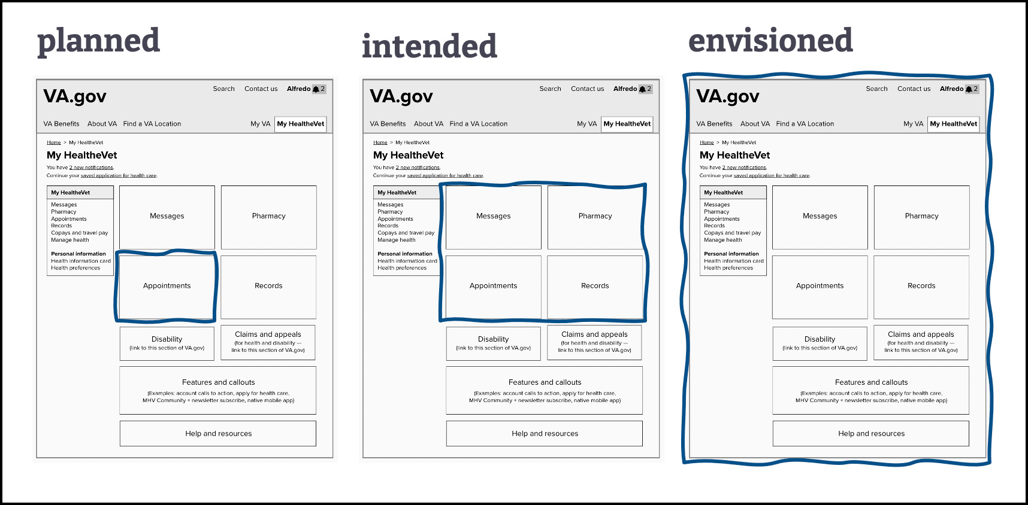
Roadmap and Progress
CLIN 0001AC
Today
PHASE
Planned
Intended
SPRINT
0
1
2
3
4
5
6
7
8
9
10
11
MONTH
September
October
November
December
January
February
EPIC
Onboard Landing Team and Kickoff Project
Recruiting, Hiring, and Onboarding
VFS Apartment Concept
Deep Dive into Research, Discovery and POC
Workshops and MVP Down Selection
Problem Definition, Approach, and Sprint Planning
Proof of Concept Design and Test

Slide 58
Monthly Calendar - September
CLIN 0001AC
Monday | Tuesday | Wednesday | Thursday | Friday
 |  | 9/1 | 9/2 | 9/3
9/6 | 9/7 | 9/8 Sprint 0 Start | 9/9 | 9/10
9/13 | 9/14 Kickoff Meeting: 11am ET | 9/15 Charter Co-Creation Session: TBD | 9/16 Stand Up: 11am ET Backlog Grooming: TBD | 9/17 Stand Up: 11am ET
9/20 Stakeholder Discussion: TBD | 9/21 | 9/22 Sprint 0 Demo: 11am ET Sprint 0 Retro: 12pm ET | 9/23 Sprint 1 Kickoff: 11am ET | 9/24
9/27 | 9/28 | 9/29 | 9/30 Monthly SteerCo: TBD Backlog Grooming: TBD | 10/1 Sprint 2 Planning: 2pm ET
SPRINT 0
SPRINT 0
SPRINT 0
SPRINT 1
SPRINT 1

Slide 59
Monthly Calendar - October
CLIN 0001AC
Monday | Tuesday | Wednesday | Thursday | Friday
10/4 | 10/5 Sprint 1 Demo: 11am ET Sprint 1 Retro: 2pm ET | 10/6 Sprint 2 Kickoff: 10am ET | 10/7 | 10/8
10/11 | 10/12 | 10/13 Backlog Grooming: 2pm ET | 10/14 Sprint 3 Planning: 11am ET | 10/15
10/18 Sprint 2 Demo: 11am ET Sprint 2 Retro: 12pm ET | 10/19 POC and MVP Check-in: 9am ET | 10/20 Sprint 3 Kickoff: 10am ET | 10/21 | 10/22
10/25 | 10/26 POC and MVP Check-in: 9am ET | 10/27 Apartment Working Group: 2pm ET Backlog Grooming: 4pm ET | 10/28 Sprint 4 Planning: 11am ET | 10/29
SPRINT 1
SPRINT 2
SPRINT 2
SPRINT 2
SPRINT 3
SPRINT 3

Slide 60
Monthly Calendar - November
CLIN 0001AC
Monday | Tuesday | Wednesday | Thursday | Friday
11/1 | 11/2 Sprint 3 Demo: 11am ET Sprint 3 Retro: 2pm ET | 11/3 Sprint 4 Kickoff: 10am ET | 11/4 | 11/5
11/8 | 11/9 | 11/10 Backlog Grooming: 2pm ET | 11/11 Sprint 5 Planning: 11am ET | 11/12
11/15 | 11/16 POC and MVP Check-in: 9am ET Sprint 4 Demo: 11am ET Sprint 4 Retro: 12pm ET | 11/17 Sprint 5 Kickoff: 10am ET | 11/18 | 11/19
11/22 | 11/23 POC and MVP Check-in: 9am ET | 11/24 Apartment Working Group: 2pm ET Backlog Grooming: 4pm ET | 11/25 Sprint 6 Planning: 11am ET | 11/26
11/29 | 11/30 POC and MVP Check-in: 9am ET Sprint 5 Demo: 11am ET Sprint 5 Retro: 12pm ET
SPRINT 3
SPRINT 4
SPRINT 4
SPRINT 4
SPRINT 5
SPRINT 5
SPRINT 5

Slide 61
CLIN 0001AC
This Project Is About
Reducing websites and interfaces
Pursuing the vision
Learning from a Proof of Concept and making iterative progress towards shipping product
Working in the open with a deep bench of OCTO Digital Engineering Crews
Collaborating and breaking down silos across the complex stakeholder landscape through collaboration and co-creation
...Is Not About
Adding to the complexity
Searching for a pain point
Starting with more research
Catering to a single Champion
Working in isolation with blinders on

Slide 62
Governance Structure
CLIN 0001AC
Leadership Team: OCTO
Charles Worthington (CTO) Jeff Barnes (DSVA) Lauren Alexanderson (Deputy CTO Health Delivery) Chris Johnston
Leadership Team: OCC
Kathy Frisbee (Executive Director, Connected Health) TBD (Product Person) TBD (Engineer)
Leadership Team: Contracting
Joshua Cohen (Contracting Officer) David Melton (Contract Specialist) Mary O’Toole (COR) Sobia Ali (Executive Assistant)
Core Team: Program Management
MO: Heather Vujovich | OCTO: TBD | OCC: TBD
Extended Team: Stakeholders
Various Digital Engineering Crews (refer to Org Chart My HealtheVet for up to date teams)
Core Team: Product Leadership
MO: TBD (Tami) | OCTO: TBD (Product Owner) | OCC: TBD
Core Team: Delivery Team
MO: Lara Siopis (UX Lead) Paula Mendoza (Scrum Master) Jared Cooke (FE Engineer) TBD (Software Engineer Lead) TBD (UX Designer) TBD (Senior Visual Designer) | OCTO: Aryeh Jacobsohn Emily Mann Meg Peters | OCC: TBD

Slide 63
Roles and Responsibilities
CLIN 0001AC
Role | Responsibility | Name | Organization
Executive Sponsors | Continuously sponsor and guide team in defining and delivering to the project goals and scope. Champion the product within the larger ecosystem. Make connections to inform the product and help the product team engage stakeholders at the right times. | Lauren Jeff | OCTO MO
Product Owner | Work with product team to generate and prioritize user stories based on research. Make decisions and help manage product activities in collaboration with Product Manager (e.g., provide guidance, remove blockers, collaborate in developing the requirements, schedule, and vision, connect with SMEs). Review, approve, and accept products, deliverables and recurring reports (Delivery Reports; Monitoring Reports; Progress, Status and Management Reports; Status of GFE Reports; Personnel Contractor Manpower Reports; Contractor Staff Rosters). | Meg | OCTO
COR | Review, approve, and accept work performed and recurring reports (Delivery Reports; Monitoring Reports; Progress, Status and Management Reports; Status of GFE Reports; Personnel Contractor Manpower Reports; Contractor Staff Rosters). Review T&M requests as appropriate. Support Program Manager with VA onboarding and invoicing as required. | Mary | OCTO
Program Manager | Accountable leader for the overall program. Define strategy and define features; manage stakeholders. Responsible for reporting and compliance. Cultivate a positive, trusting, and cooperative working relationship with the Government and all other vendors supporting this work. Responsible for future state journey / vision. | Drink | MO
Product Manager | Ultimate decision maker for the product. Has working knowledge across capabilities (research, design, dev) and product development lifecycle. | TBD | MO
Scrum Master | Assist Product Manager and Product Owner with backlog management and overall delivery. Facilitate an agile, lean, user-centered design approach as described in CEDAR PWS Section 4.9. Lead agile ceremonies. Empowers team’s work with policy, legal, finance, and communications teams. Tracks delivery metrics. | Paula | MO
Business Analyst | Business expert that has deep understanding of current state journey. Typically 10+ years experience across lines of business. | Jeff / Matthew | MO
Policy Expert | Relevant subject-matter expertise (and the desire to improve policy); this skillset may come from your internal team or from an external stakeholder | Jeff / Matthew | MO

Slide 64
Roles and Responsibilities
CLIN 0001AC
Role | Responsibility | Name | Organization
Design Lead | Lead and guide the design team. Work with Product Manager to develop and scope work and lead the design team to deliver at the highest performance and consistency for research, UX design, and visual design. Ensure accessibility is considered throughout the design process. Collaborate with multidisciplinary product teams and government staff, facilitate workshops, and lead with agility. | TBD | MO
UX Design Lead | Turn research insights into design decisions; designs end-to-end UX based on user research; includes accessibility and service design. Personalize solutions for the individual or team using the product. Support the design team in activities including content creation, workshop preparation, facilitation, interaction design, synthesis, and others. | TBD | MO
UX Designer | Maintain a consistent look, feel, and voice across user facing sites and services. Create assets including navigation designs, wireframes, information architecture diagrams, design prototypes. Maintain a high level of quality and consistency and conducts site audits. Ensure all work products from the team are in line with brand standard including presentations and murals. Incorporate best practices defined in the VA Design System and VA Content Style Guide (https://design.va.gov/). | TBD | MO
Delivery Manager | Maintain a consistent look, feel, and voice across user facing sites and services. Incorporate best practices defined in the VA Design System and VA Content Style Guide (https://design.va.gov/). Support the design team in activities including content creation, workshop preparation, facilitation, interaction design, synthesis, and others as needed. | TBD | MO
Content Strategist/ Plain Language Writer | Write new content following the guidelines in the content style guide; understanding of relationship between content and accessibility (or access to accessibility experts). Content strategy, copy editing and storytelling responsibility for user facing materials and work product. | TBD | MO
Backend Engineer | Design, build, and maintain the server side of the application. Build the structure of the software application. | TBD | Pluribus

Slide 65
Roles and Responsibilities
CLIN 0001AC
Role | Responsibility | Name | Organization
Visual Designer | Maintain a consistent look, feel, and voice across user facing sites and services. Incorporate best practices defined in the VA Design System and VA Content Style Guide (https://design.va.gov/). Support the design team in activities including content creation, workshop preparation, facilitation, interaction design, synthesis, and others as needed. | TBD | MO
User Researcher | Actively involve users in the design of all solutions. Incorporate best practices for modern user research and usability testing, such as (but not limited to) creating user personas, problem space definitions, affinity maps, user flow diagrams, user research plans, conversation guides, and user research synthesis. Recruit participants using inclusive strategies. Protect participant information appropriately. Document and present research processes and results. | TBD | MO
Service Designer | Research customer behavior and common customer responses to particular experiences. Design services to improve customer experience. | TBD | MO
Interaction Designer | Determine customer needs and define product interactions necessary to achieve them. Compile user, business and technical requirements to create product information architecture. Create wireframes and prototypes that illustrate key product interactions. | TBD | MO
Information Architect | Plan and design the information structure for the product application. Organize information and design strategies using data from usability testing. Create user flows, wireframes, site maps, mockups and storyboards. | TBD | MO
QA Testing | Use automated testing frameworks to create unit tests, integration tests, functional/black box tests, and load tests (or their equivalents as applicable) to test 100% of functionality delivered. Strive for compliance with Test Driven Development practices. Ensure configuration and sensitive data, including data the VA defines as sensitive, are not present in source code, and are stored in encrypted credential management systems. | Nadya | Pluribus

Slide 66
Roles and Responsibilities
CLIN 0001AC
Role | Responsibility | Name | Organization
Performance Evaluation | Continuous measurement and analysis. Communicate project metrics. | TBD | TBD
Development Leader / Solution Architect | Vets and explores technology solutions during research and discovery. Develops a landscape of solutions and options. Develops understanding of current state technical constraints and technology ecosystem. Builds low code solutions. Deliver all code not containing configuration or sensitive data to an open source repository per OMB Guidance M-16-21. | TBD | MO
Frontend Developer | Optimize web applications for mobile-first operation, with all solutions being equally available on both mobile and desktop whenever possible. Incorporate robust accessibility principles into design, development and testing for all web applications to deliver high-quality digital experiences to users of assistive devices. Accessibility testing while coding | Jared Nadya | MO
Analytics | Identify and communicate data driven insights that allow stakeholders to make more informed decisions. | TBD | MO

Slide 67
Project Tool Stack
CLIN 0001AC

Slide 68
Project Meeting Norms
CLIN 0001AC

Slide 69
VA.gov Resources
CLIN 0001AC

Slide 70
Deliverables Tracker
CLIN 0001AC
Expected Delivery | Deliverable | Acceptance Criteria | Owner | Status
NLT the 7th day of the month following each reporting period. | Delivery Report | (a) Gov’t Product Owner agrees that the Contractor provided a monthly report, detailing and providing links to all stories, epics, and other work completed. (b) Report includes all work accepted by the Product Owner and Contracting Officer Representative at the end of each sprint. (c) This report includes additional details about the project status, sprint team velocity, sprint team goal completion, and highlight project risks. | MO | On Track
NLT the 7th day of the month following each reporting period. | Monitoring Report | (a) Gov’t Product Owner agrees that the Contractor provided a monthly report, highlighting and providing links to key infrastructure and application monitoring data. (b) Report includes details with links to documentation for any critical incidents or outage events that resulted in service outages or significant service degradations. (c) Contractor attached or provided links to postmortem documentation for all critical incidents or outage events. | MO | On Track
NLT the 7th day of the month following each reporting period. | Contractor’s Progress, Status and Management Report | Gov’t Product Owner agrees that the status of the Task Orders performance has been addressed in the Quarterly Status Report. | MO | On Track
NLT the 7th day of the month following each reporting period. | Status of Government Furnished Equipment Report | Gov’t Product Owner agrees that the GFE Report includes the following items related to GFE: Task Order; Project Name, Type of Equipment, VA Bar Code, Location, Value, Total Number of Pieces, Total Value of Equipment, Anticipated Transfer Date to Government, and Anticipated Transfer Location. | MO | On Track
NLT the 7th day of the month following each reporting period. | Personnel Contractor Manpower Report | Gov’t Product Owner agrees that the Personnel Contractor Manpower Report at the individual Task Order Level includes all of the required information outlined in the Base PWS section 9.2.3. | MO | On Track
Within 3 days from the date of award and updated as personnel changes throughout the PoP. | Contractor Staff Roster | Gov’t Product Owner agrees that this report includes all Contractor and Subcontractor employees and was provided within three business days after Task Order award for all personnel employed to begin their background investigations. A revised roster will be provided when there are any personnel changes. | MO | On Track
Within 10 business days of each sprint. | Sprint plan for each sprint | Gov't Product Owner agrees that the goals for each iteration have been met. | OCTO | Not Started

Slide 71
VA CEDAR IDIQ TO1
VETERAN-FACING SERVICES – DIGITAL HEALTH MODERNIZATION
Compliance, Governance and Reporting
CLIN 0001AA: Delivery Report
CLIN 0001AB: Monitoring Report
CLIN 0001AC: Contractor’s Progress, Status and Management Report
CLIN 0001AD: Status of Government Furnished Equipment Report
CLIN 0001AE: Personnel Contractor Manpower Report
CLIN 0001AF: Contractor Staff Roster

Slide 72
Status of Government Furnished Equipment Report
CLIN 0001AD
The Contractor shall submit a monthly GFE report in accordance with Base PWS 9.2.2.
Monthly GFE Status Report

Slide 73
Monthly GFE Status Report
CLIN 0001AD
Name | GFE
Jeff | None
Shawn | None
Paula | None
Jeff | None
Matthew | None
Jared / Nadya | None
Nadya | None

Slide 74
VA CEDAR IDIQ TO1
VETERAN-FACING SERVICES – DIGITAL HEALTH MODERNIZATION
Compliance, Governance and Reporting
CLIN 0001AA: Delivery Report
CLIN 0001AB: Monitoring Report
CLIN 0001AC: Contractor’s Progress, Status and Management Report
CLIN 0001AD: Status of Government Furnished Equipment Report
CLIN 0001AE: Personnel Contractor Manpower Report
CLIN 0001AF: Contractor Staff Roster

Slide 75
Personnel Contractor Manpower Report
CLIN 0001AE
The Contractor shall provide a monthly report, detailing the current staffing status In accordance with the Base PWS 9.2.3.

Slide 76
Personnel Contractor Manpower Report
CLIN 0001AE
 | Role | Name | Organization | Competitive Candidates | Stage | Status
1 | Program Manager | Jeff (Interim) | MO | 1 | Offer Letter | Transition
2 | Product Manager | Jeff (Interim) | TBD | 2 |  | Priority
3 | Service Designer | Paula | MO |  |  | Closed
4 | Business Analyst | Tami | Advisory Serve |  |  | Closed
5 | Policy Expert | Matthew | MO |  |  | Closed
6 | UX Design Lead | TBD | MO | 2 | Interviewing | Priority
7 | UX Designer | TBD | TBD | 2 | Interviewing | Priority
8 | Delivery Manager | Heather | MO |  | Hired | Transition
9 | Content Strategist/Plain Language Writer | TBD | TBD |  | Posted | Active
10 | Backend Engineer | TBD | TBD |  |  | Active
11 | Visual Designer | TBD | TBD |  |  | Queue
12 | User Researcher | TBD | TBD |  |  | Queue
13 | QA Testing | Nadya | Pluribus |  |  | Closed
14 | Analytics | Nadya | Pluribus |  |  | Queue
15 | Front End Developer | Jared / Nadya | MO / Pluribus |  |  | Closed

Slide 77
VA CEDAR IDIQ TO1
VETERAN-FACING SERVICES – DIGITAL HEALTH MODERNIZATION
Compliance, Governance and Reporting
CLIN 0001AA: Delivery Report
CLIN 0001AB: Monitoring Report
CLIN 0001AC: Contractor’s Progress, Status and Management Report
CLIN 0001AD: Status of Government Furnished Equipment Report
CLIN 0001AE: Personnel Contractor Manpower Report
CLIN 0001AF: Contractor Staff Roster

Slide 78
Contractor Staff Roster
CLIN 0001AF
The Contractor shall submit a roster to the COR in accordance with Base PWS 9.2.4.
Contractor Staff Roster
Update Log

Slide 79
Contractor Staff Roster & PIV Status
CLIN 0001AF
Contractor Full Name | Company | Employee Status | Role | Email | Onboarding Status | Fingerprint Phase | Tier 2 Background Investigation Phase | GFE
Jeff Scheire | MO Studio / Prime | Active | Executive Champion / SME | jeff@themostudio.com | N/A | Pending adjudication | N/A | No
Shawn Drinkard | MO Studio / Prime | Active | Program Manager | drink@themostudio.com | In Progress | Pending adjudication | Pre-award BI forms uploaded to SharePoint on 10/25 | No
Lara Siopis | MO Studio / Prime | Inactive | Product Manager | lara@themostudio.com | In Active | N/A | N/A | No
Heather Vujovich | MO Studio / Prime | Active | Delivery Manager | heather.vujovich@themostudio.com | In Progress | To be scheduled | Need to upload forms to SharePoint | No
Matthew Stiner | MO Studio / Prime | Active | SME | matt@themostudio.com | N/A | Pending adjudication | N/A | No
Paula Mendoza | MO Studio / Prime | Active | Scrum Master | paula@themostudio.com | In Progress | Pending adjudication | Pre-award BI forms uploaded to SharePoint on 10/25 | No
Jared Cooke | MO Studio / Prime | Active | Front-End Developer | jared@themostudio.com | In Progress | Pending adjudication | Pre-award BI forms uploaded to SharePoint on 10/25 | No
Nadya Primak | Pluribus / Sub | Active | Front-End Developer | nprimak@pluribusdigital.com | In Progress | Pending adjudication | Pre-award BI forms uploaded to SharePoint on 10/25 | No
Tamera Corson | Serve Advisory/Sub | Active | Project Manager | tamera.corson@serveadvisory.com | In Progress | To be scheduled | Need to upload forms to SharePoint | No
Notes:
Drink: Identify PIV Stage completion and process. Will adjust this chart based on those findings today.

Slide 80
Staff Roster Update Log
CLIN 0001AF
Changes / Updates | Updated by | Date
Added Nadya Primak, she will as FE Engineer on 1 Oct 21 | Shawn Drinkard | 9/23/2021
Added responsibilities per charter and discovery sessions during Sprint 1. | Lara Siopis | 10/4/2021
Changed Shawn Drinkard’s role to focus on Ops (e.g., PIV Onboarding, DesignOps toolstack, contract compliance, invoicing, and ad hoc operational support) | Shawn Drinkard | 11/1/2021
Added Heather Vujovich as Delivery Manager | Shawn Drinkard | 11/1/2021
Added Tamera Corson as Project Manager / SME | Shawn Drinkard | 11/1/2021

